Slide 1
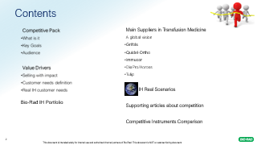
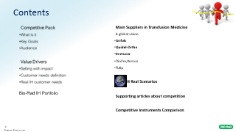
IH Competitive Pack
Marketing Automation
December 2024

Slide 2

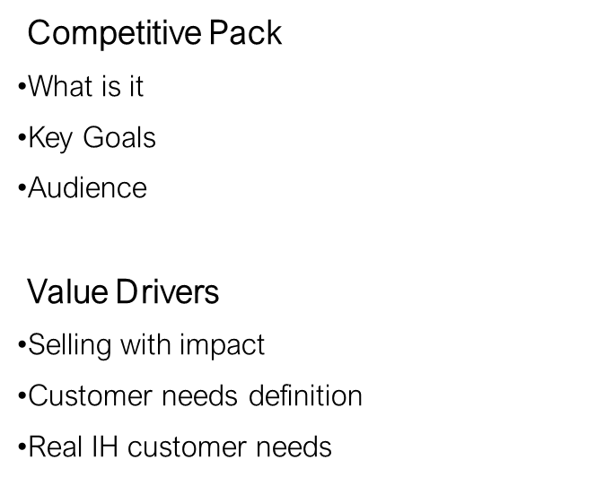

Contents
Main Suppliers in Transfusion Medicine
A global vision
Grifols
Quidel-Ortho
Immucor
DiaPro/Across
Tulip
IH Real Scenarios
Supporting articles about competition
Competitive Instruments Comparison
Bio-Rad IH Portfolio

Slide 3

Competitive Pack
What is it?
This presentation is a living document that intends to consolidate all the important information about the key players in Immunohematology market.
It is a work in progress document, always in need to be updated*.
What is the goal?
The goal is to give insights that can help our teams to win new opportunities in IH, simplifying the selling process.
Who is the audience?
The sales team: account managers, sales managers, field application specialists, Channel partners and all the ones that have the need to face the customer and the attack from the competition.
This is NOT a customer facing presentation
*A meeting between MKT and GCO will happen regularly to discuss and update the content.

Slide 4

Customer Value Drivers
How do customers make purchasing decisions?
What do customers value?
To assess what has value to a customer, companies must think like their customers. People buy what is important to them and it is important to recognize that this is not always related to price. Customer value drivers are selling points—from product performance to ease of delivery—that make our product or service valuable to customers.
How do customers define value?
Customers are willing to pay more to purchase a product or service when they received something else in addition to the benefits inherent in the product or service itself.

Slide 5
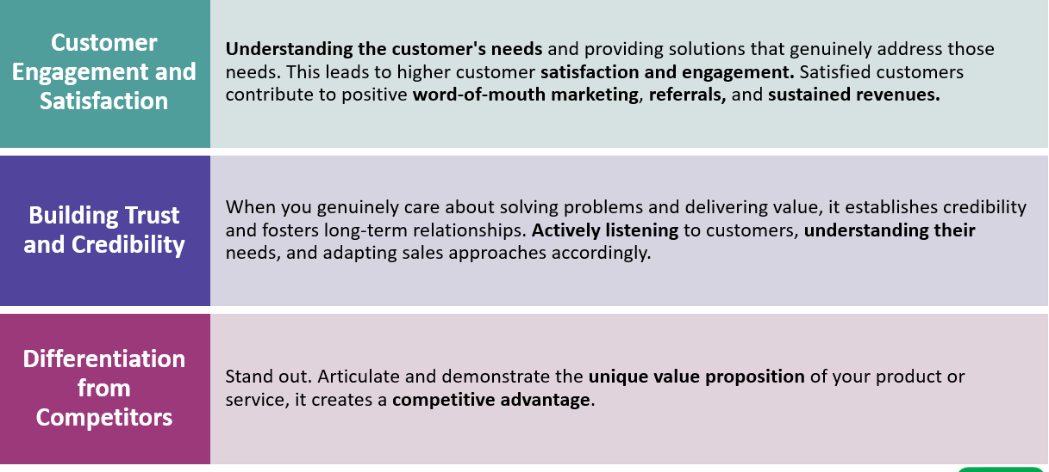
Selling with impact-main drivers

Slide 6


Customer Needs
A need is defined as any statement made by the customer that expresses a want or concern.
A customer who is completely satisfied with the present situation doesn’t feel any need to change what he is currently doing.
Example of needs – concerns:

Slide 7
Customer Pains Points leads us to their Needs
Customer Pain Points* | Customer Need | Bio-Rad Solution
Reliability and Sensitivity of Instruments | Minimum Down time of the systems | Increase of robustness in the new versions of the IH systems-IH 500 Next
 | Trustful results | Sensitive and specific technology, quality of reagents, improvement of the interpretation algorithm
Maintenance | Reduced and easy maintenance | No daily maintenance, easy steps, wizard
Ease of use and interface complexity | System easy to use, adapted to any staff skills | Simple software
Space Constrains | Systems to take less space, improve footprint | Flexibility for some systems to be benchtop
Staff competence and shortage | More qualified staff, more staff, dedicated Reference Labs | More automation, Remote validation, IH-A^{b}ID software, Educational Tools
Instrument availability and scability | Flexibility to have different instruments, for different uses and lab volumes 24 hours support | Manual, Semi Automated and automated systems
Training | Trainings to be more frequent and effective | Bio-Rad Training Tools, expert IH team, Envoke
Support | 24 hours support Dedicated teams to IH in the companies | Dedicated and specialized teams
*Data source: 2024 Voice of Customer

Slide 8

IH Customer Needs
Which needs
are you facing
in the IH market?

Slide 9
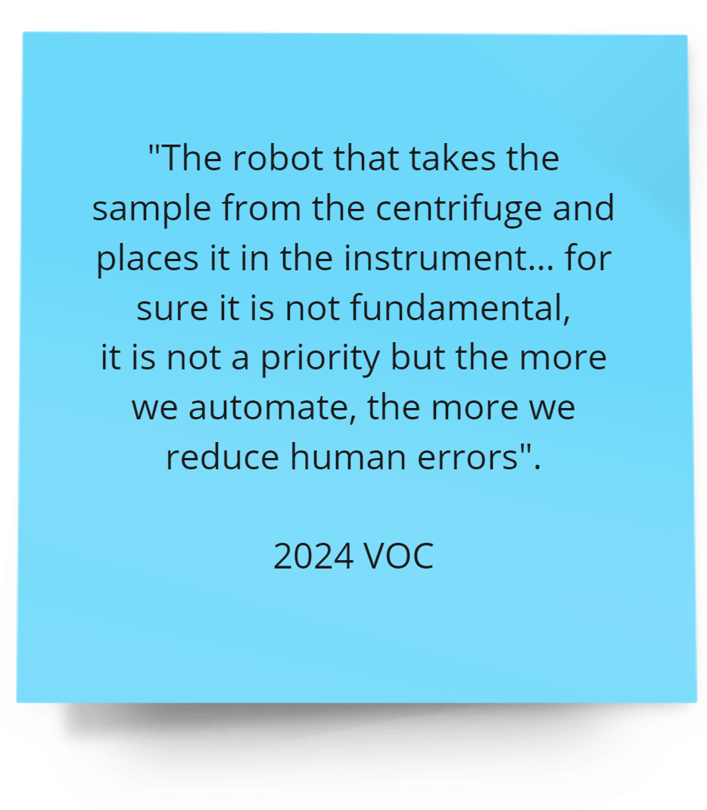
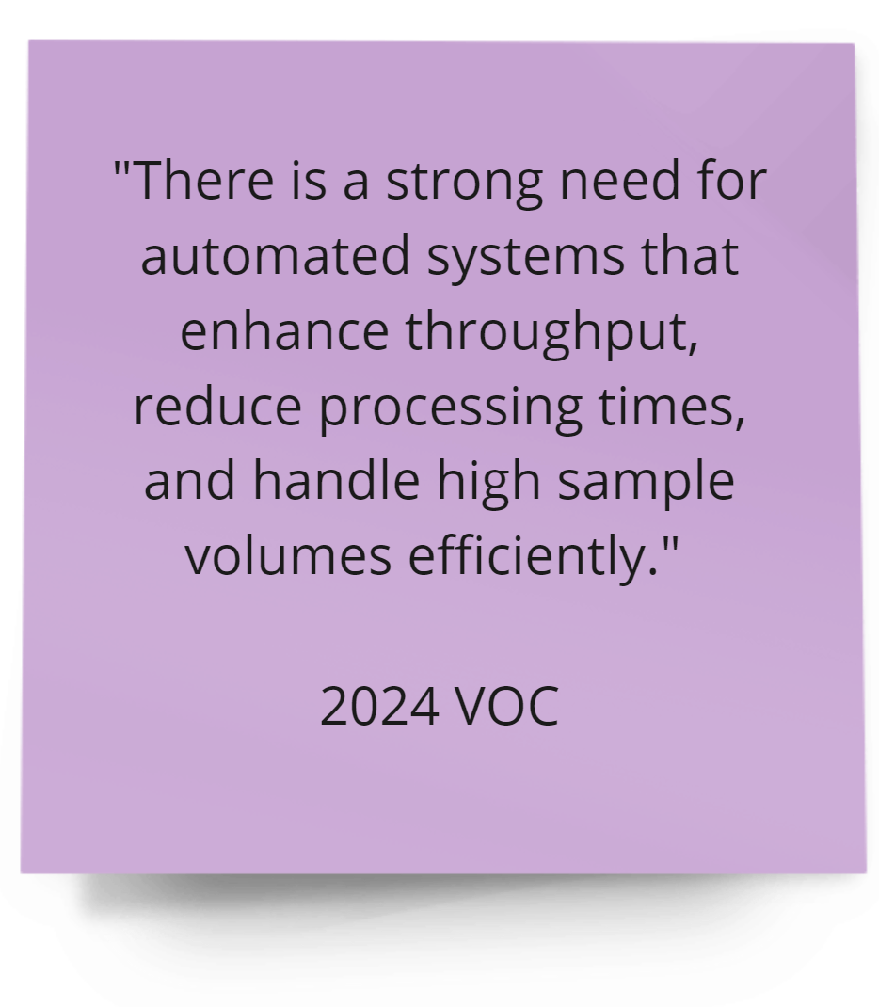
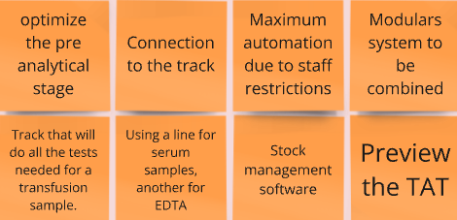
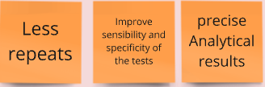
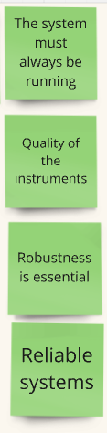
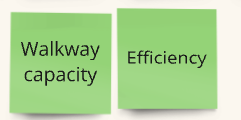
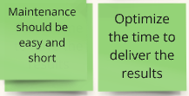



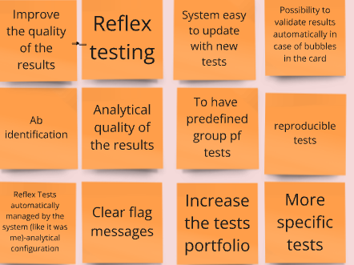
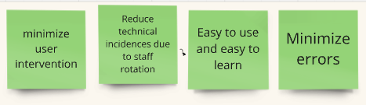
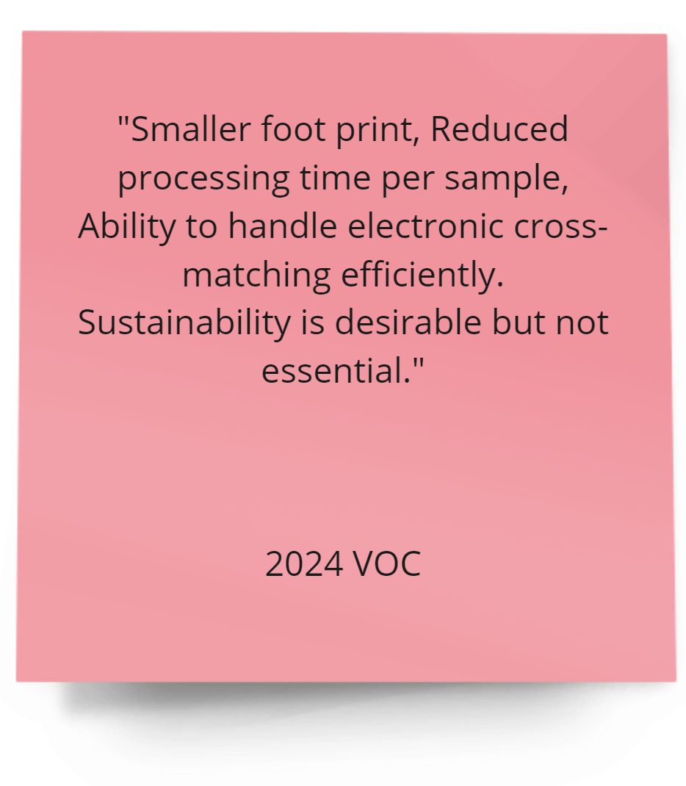

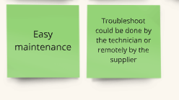

IH Real Customer Needs
Data source: 2024 Voice of Customer

Slide 10
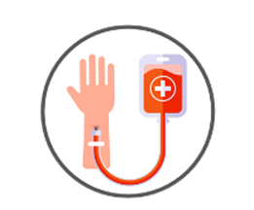
We should also look at IH Customer Trends
Turn Around Time Predictability
In combination with result quality, TAT is the major KPI for transfusion lab success. Consolidation of activities imposes requirements for more predicable TAT.
Skilled Staff Shortage
The specificity of IH specialty is incompatible with multidisciplinary approach for personal in clinical diagnostic labs and long training requirements (several years). Fully automated with reflex testing capacity is the only alternative to mitigate the staff shortage.
HIGH
PRIORITY
HIGH
PRIORITY

Slide 11
Bio-Rad IH Portfolio - Value Proposition

Slide 12


- A History of Innovation
Bio-Rad has been pioneering innovation in transfusion diagnostics for more than 70 years
We have a legacy of overcoming challenges to succeed
Our history defines our future - we continue to deliver products and services to address customer needs
What is our value proposition?
Bio-Rad offers a scalable and networked transfusion
medicine solutions with fully automated, semi-automated
and/or manual gel/tube options.
There is a fit of every unique work environment and budget.
Notes:
Bio-Rad have a long established reputation in transfusion diagnostics through the history of both Bio-Test and DiaMed and we have a proven legacy of continually overcoming challenges to succeed for our customers. And why is that important you may ask….Well it is important because our history defines who we are today and we continue to provide products and services to address customer needs.

Slide 13
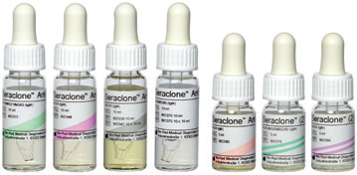
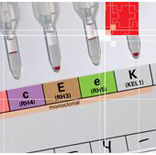
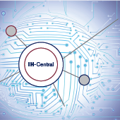
- Portfolio
Conventional line
Reagents, Small Instruments
Gel Cards
Reagents, Manual, Automation
Software
Global Software Solution

Slide 14
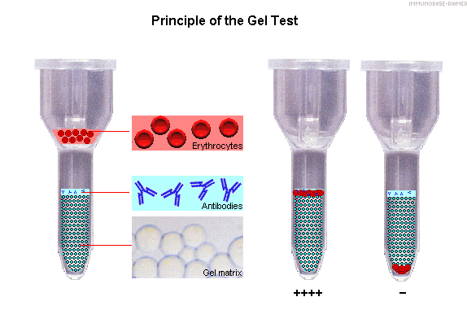
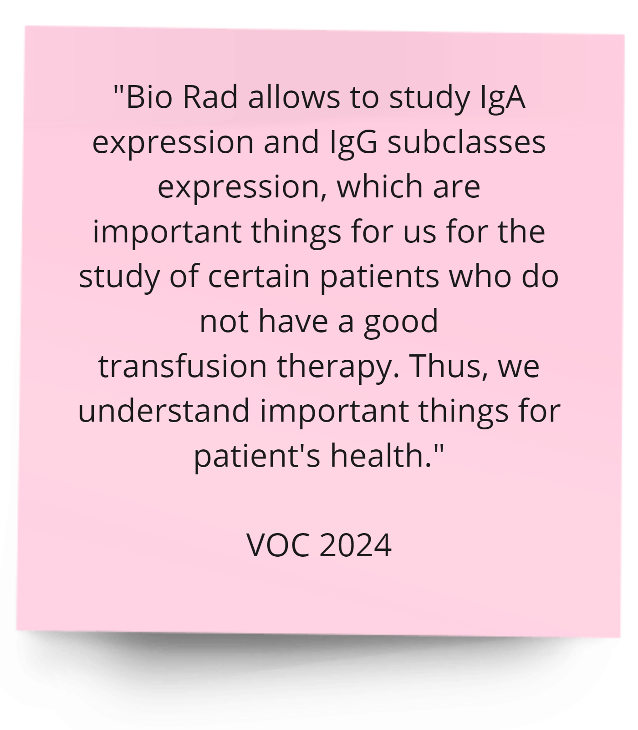
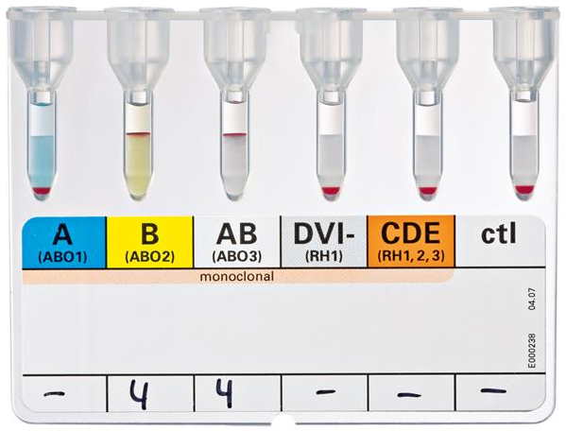
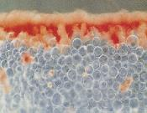
- Gel Technology
  No Microscopy is required
  No Wash IAT principle
  Detect Mixed field
  Simple and Rapid to perform
  Easy and standardized
  Interpretations
  Easy Grading for positive results
  Easy handling of large batches
  Small Sample volumes
  Wide Range of test Combinations
  Stable Reactions
  Automation

Slide 15
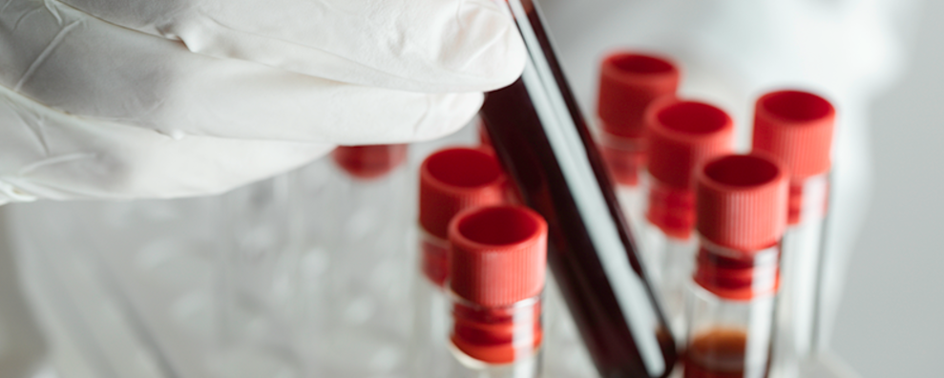
- Gel Technology
The Power of Automated Gel-based ID-Cards in Routine Immunohematology Workflows
Immunohematology assays are pivotal to the carrying out of blood grouping, antibody screening and transfusions, and represent a critically time-dependent stage in the patient management pathway.
The 853-bed Saint-Denis Delafontaine Hospital north of Paris offers a full suite of medical and surgical specialities to a local population of approximately 435,000. The transfusion laboratory sits within the hospital’s hematology department and operates 24/7 to provide a wide range of cytology, hemostasis and immunohematology testing services. It receives samples from multiple wards on an hourly basis and performs approximately 25,000 blood group and antibody screening tests each year, incl. direct and indirect antiglobulin tests, single antigen typing and crossmatch testing. Around 2,000 of these samples come from the hospital’s large maternity ward, which sees up to 5,000 births anually.
In Biomedical Scientist
Unfortunately, performing these tests manually – incl. running the assays, analysing results, managing reagent traceability, and archiving findings – is a formidable challenge for laboratories, demanding significant time and labour, and specialized expertise. Introducing gel-based automated testing can help to streamline workflows and improve efficiency for enhanced patient care.

Slide 16
- Gel Technology
The Power of Automated Gel-based ID-Cards in Routine Immunohematology Workflows
In the past, routine immunohematology testing was conducted on an automated system, with blood typing, antibody screening and reagent traceability being performed manually. This was very time consuming and resulted in little walk-away time for technicians. To address these issues, the lab acquired the Bio-Rad IH-500 and IH-1000 Systems with gel ID-Cards, couples with IH-Com data management software, in 2016. Adopting these benchtops gel-base immunohematology platforms allowed the laboratory to automate almost all of its testing protocols, freeing up to 1.5 FTEs, enabling lab technicians to focus on other important tasts like throughput and large reagent capacity. The IH-500 complements this platform by providing a platform for lower-volume, specialist tests – such as antibody identification, extended phenotyping, and compatibility testing – as well as offering redundancy in case of instrument downtime.
The platforms complete analyses rapidly, which is especially important in case of alloimmunised patients or during emergencies, and Bio-Rad gel ID-Card technology is extremely sensitive, leading to high quality and reliable results. Samples can be added continuously – without interrupting a run – for optimized throughput and testing efficiency, and the devices automatically perform weekly maintenance, requiring very little manual input and preventing downtime or testing blacklogs.
The accompanying IH-Com software automatically archives results, images, reagent lot information and quality controls with full traceability, enabling lab staff to conveniently view information in one central location for straightforward validation, device management, and data transfer.
“We are very satisfied with our gel-based platforms from Bio-Rad, and they give us confidence in the results we provide to clinicians. Coupled with the IH-Com software, the IH-500 and IH-1000 enable us to easily manage our substantial and unpredictable workload, so that we can contribute to the hospital’s high standard of patient care.”
In Biomedical Scientist

Slide 17
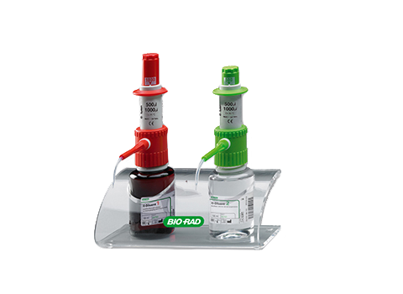
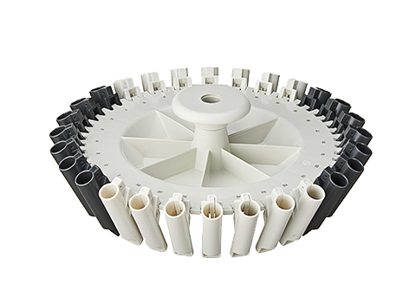
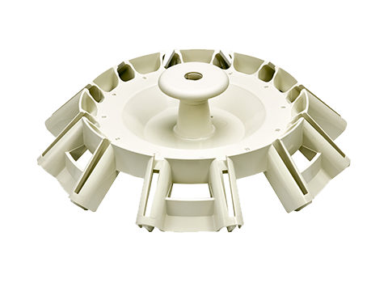
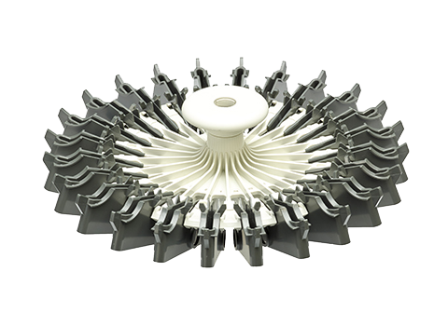
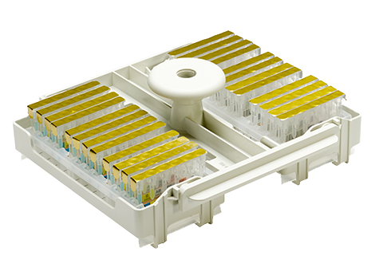
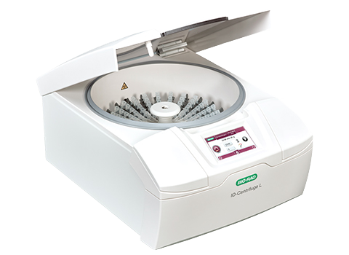
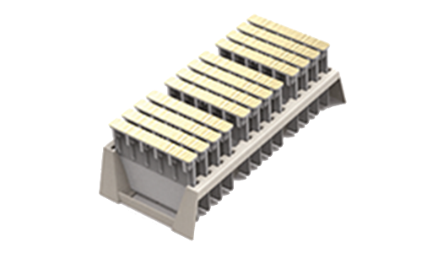
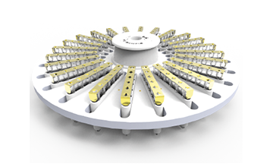
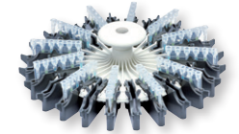
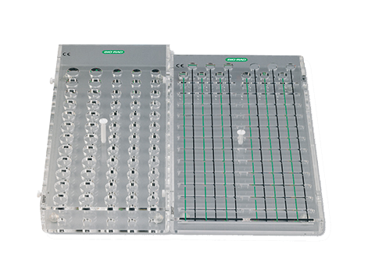
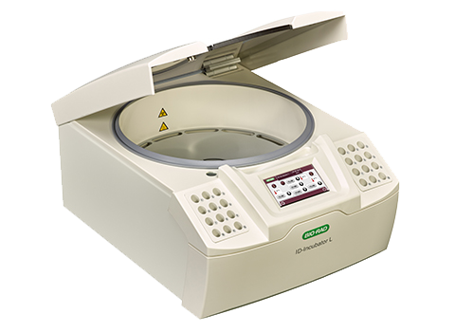
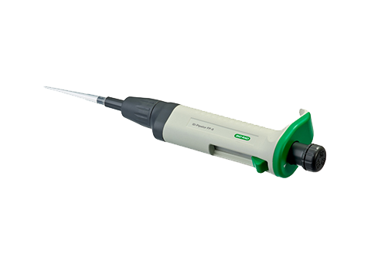
- Manual System for ID-Cards
Head 2 Rack
Head 28 Tubes
Head 12 Tubes
Head 24 Cards
ID-Dispenser
ID-Card Rack
Head 24 ID-Cards
Saxo centrifuge head
ID-Centrifuge L
ID-Pipetor
ID Working tables
ID-Incubator L

Slide 18
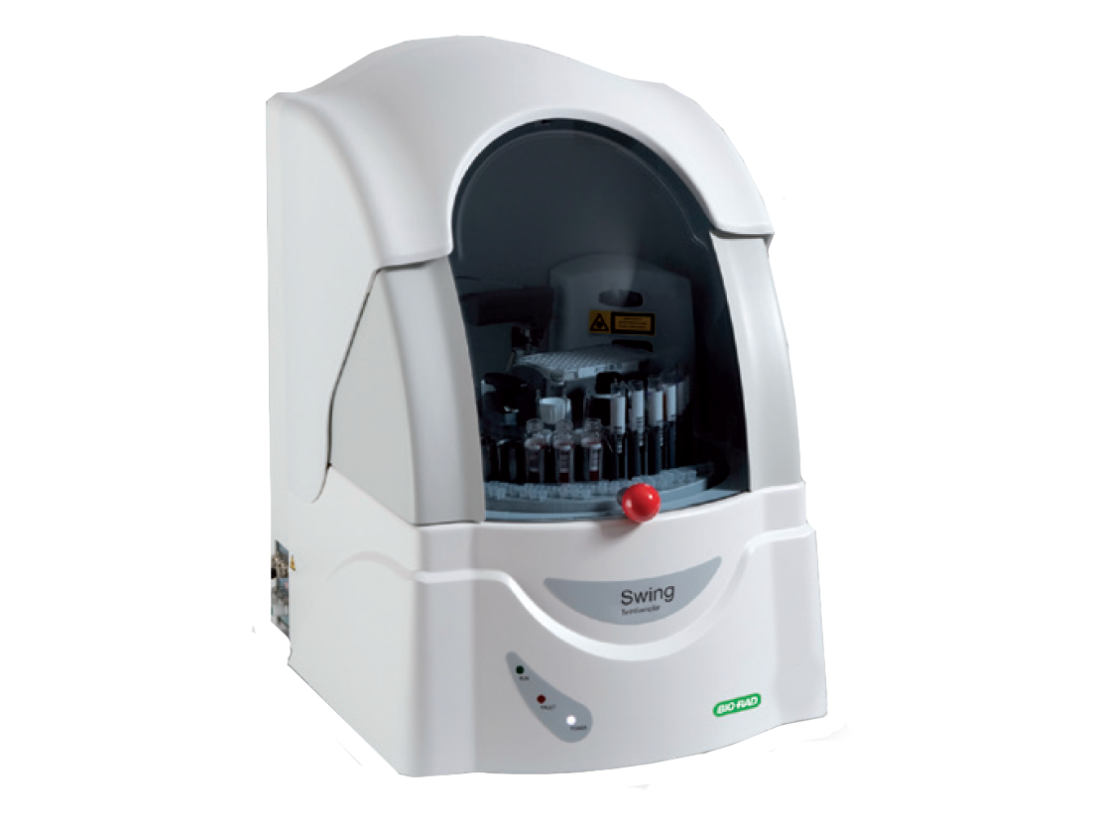
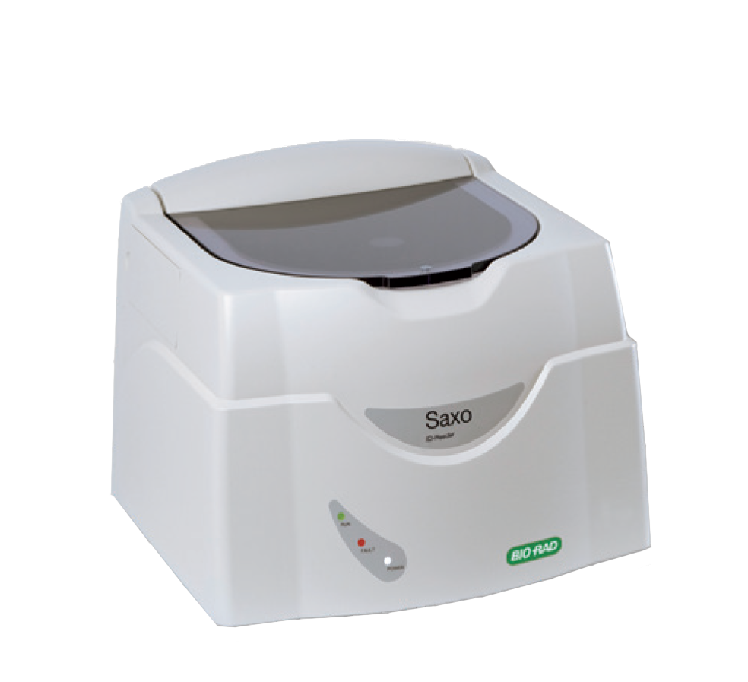
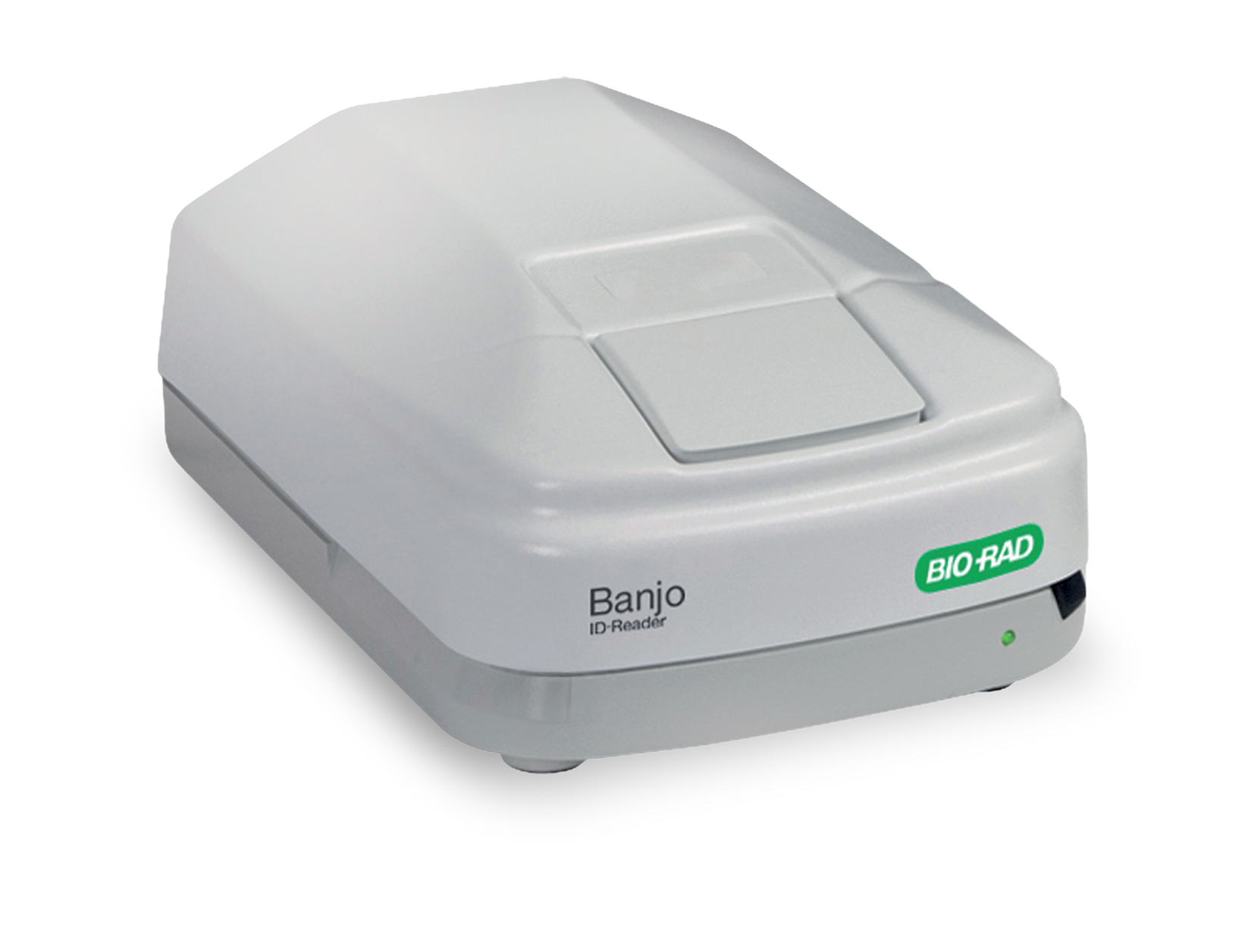
- Semi Automated System for ID-Cards
Swing TwinSampler
Saxo ID Reader
Banjo ID Reader

Slide 19
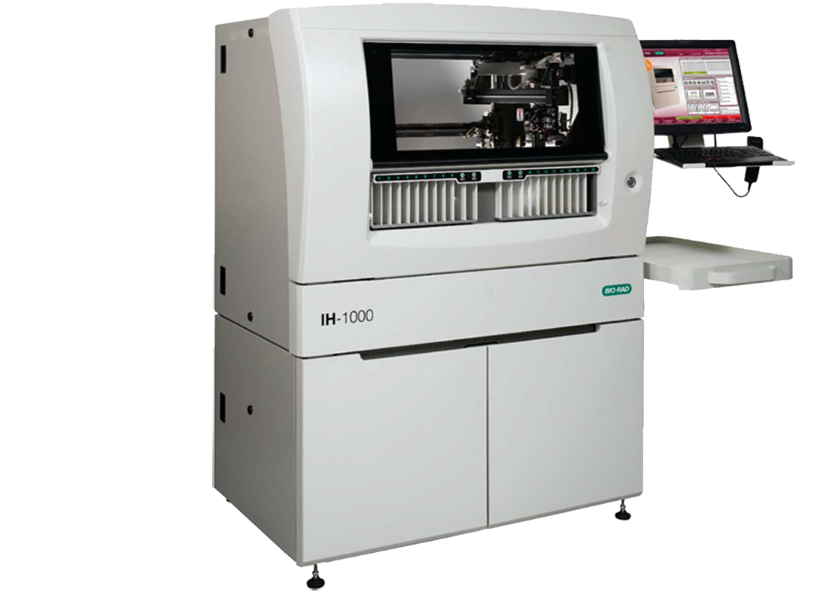
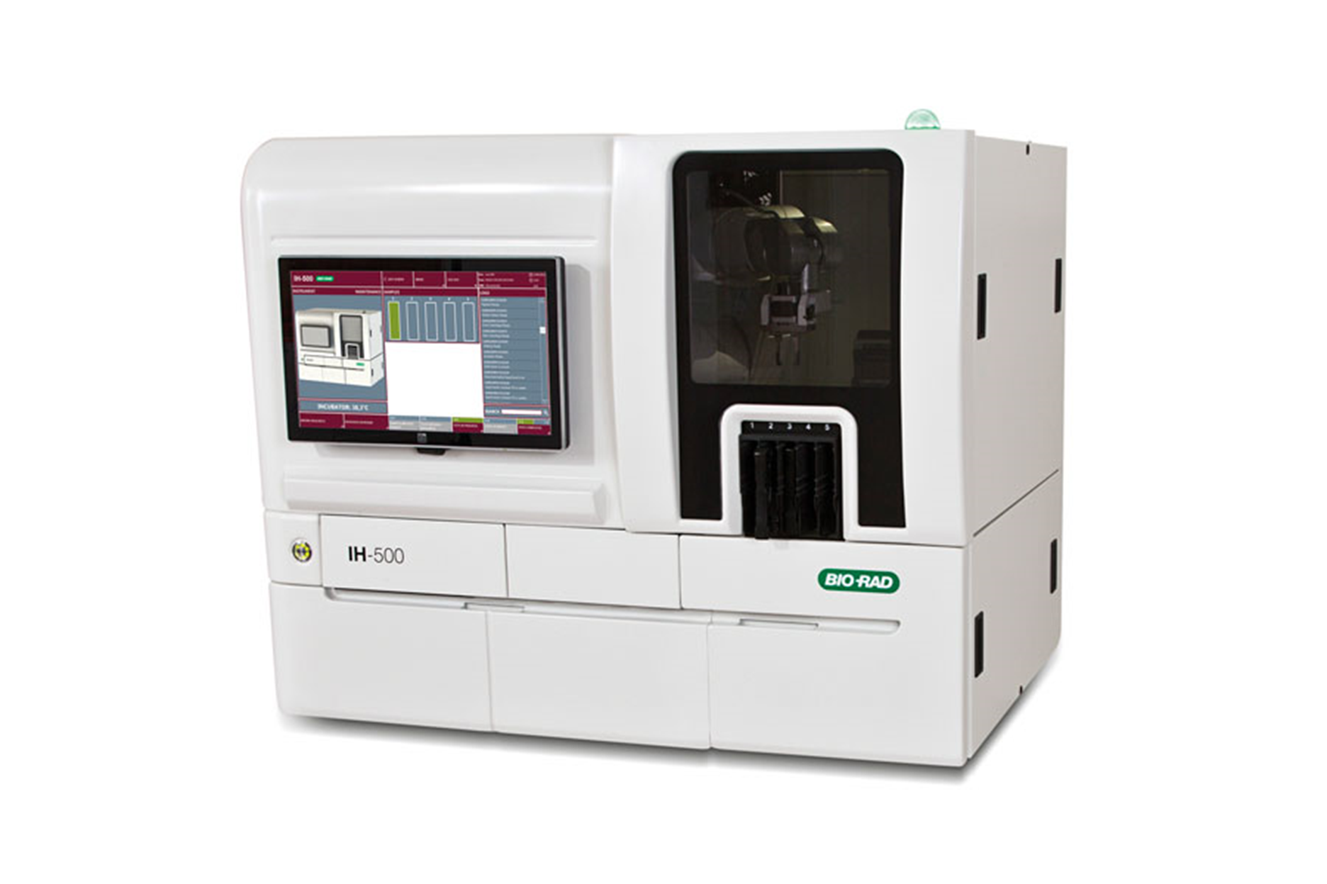

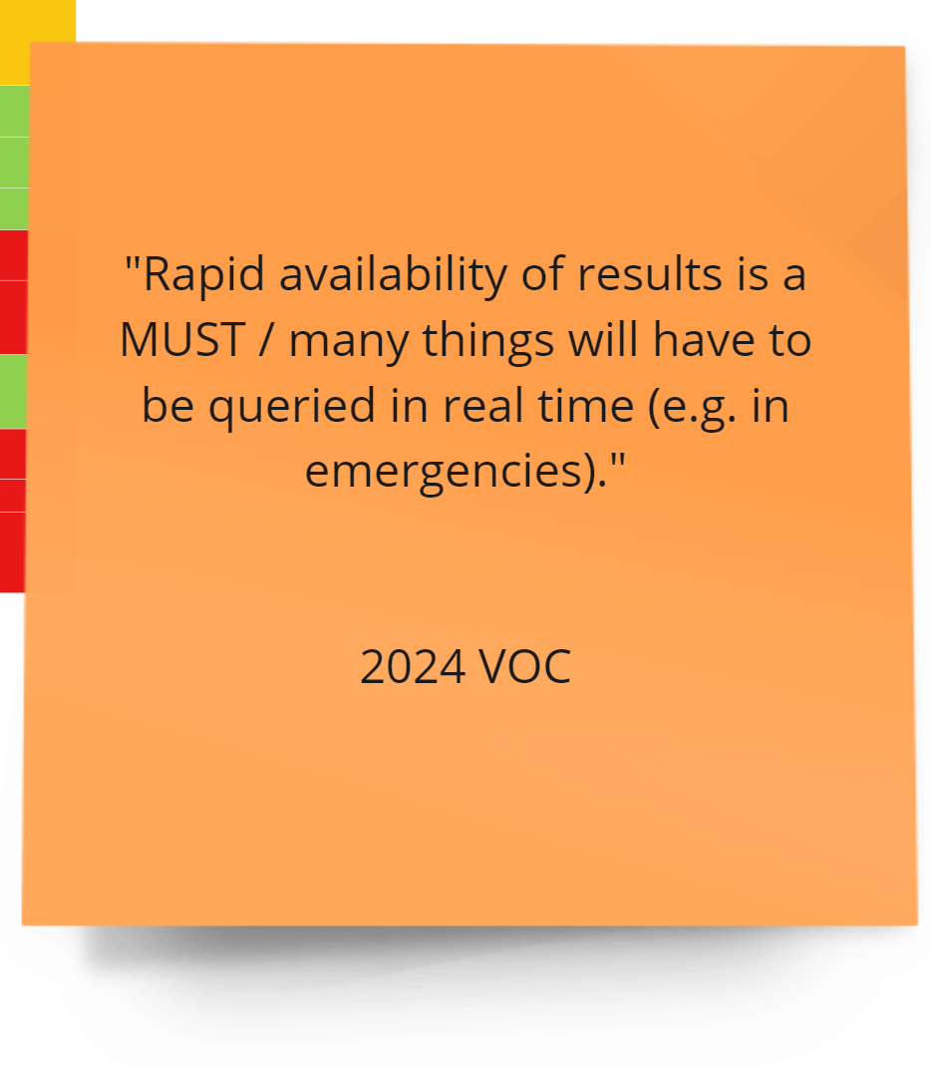
- Fully Automated System for ID-Cards

Slide 20
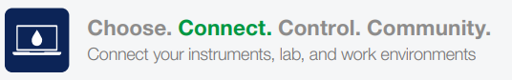
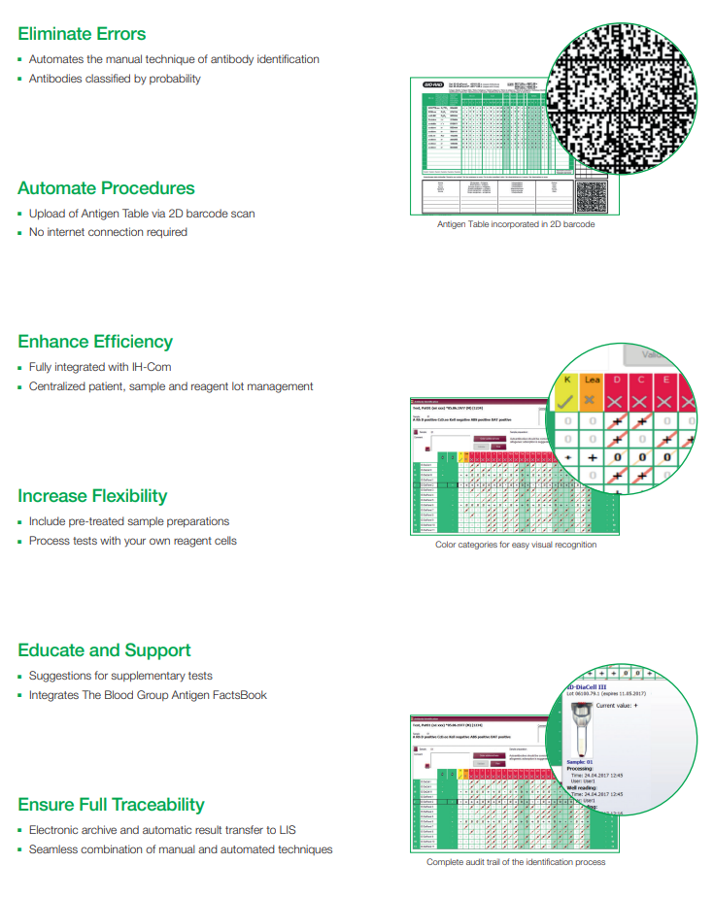
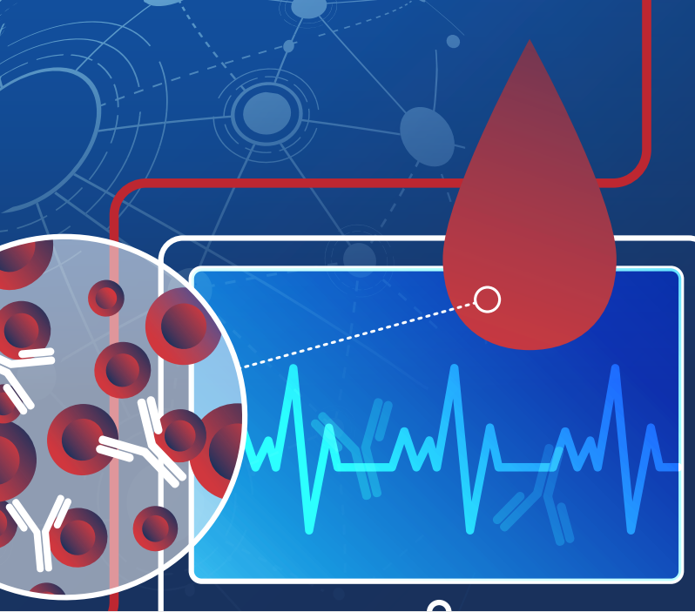
- Software Solutions
IH-A^{b}ID Integrated Antibody Identification Software
Eliminate Errors Automates the manual technique of antibody identification Antibodies classified by probability
Automate Procedures Upload of Antigen Table via 2D barcode scan No internet connection required
Enhance Efficiency Fully integrated with IH-Com Centralized patient, sample and reagent lot management
Increase Flexibility Include pre-treated sample preparations Process tests with your own reagent cells
Educate and Support Suggestions for supplementary tests Integrates The Blood Group Antigen FactsBook
Ensure Full Traceability Electronic archive and automatic result transfer to LIS Seamless combination of manual and automated techniques

Slide 21
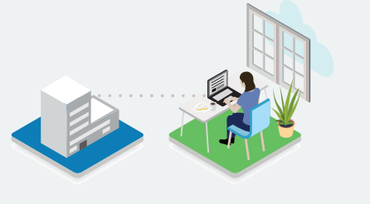

- Software Solutions
IH-Web Remote Result Management Software
Remote Result Management Transfusion laboratories working around the clock, can use the IH-Web software module to connect generalists and decision-makers to the same IH-Com database regardless of their location. This CE-marked, FDA-approved solution allows for hospital intranet connection and provides a bidirectional interface for secure interactivity.
Fully Integrated with IH-Com IH-Web is an additonal software module for IH-Com which enables requests and results to be remotely managed via the intranet using your standard web browser. IH-Web is fully integrated with IH-Com; no additional software is required.
Traceability Complete transfusion requests and result management. Result images generated by Bio-Rad instrumentation are clearly presented in IH-Web and the full search functionality of IH-Com is exploited.
Ease of Use By implementing the same logic steps and familiar interface of IH-Com
Productivity Remote connection can be established anytime, anywhere. IH-Web allows the same result verification steps to be performed as in IH-Com.
Safety Request supplementary tests or repeats. Add comments and edit results IH-Web provides greater peace of mind through improved patient safety.
Stay Connected Remote. Manage transfusion requests and results using your web browser. Result. View images, edit results, search and request additional tests. Release. Validate results from whereever you are and whenever you want.

Slide 22
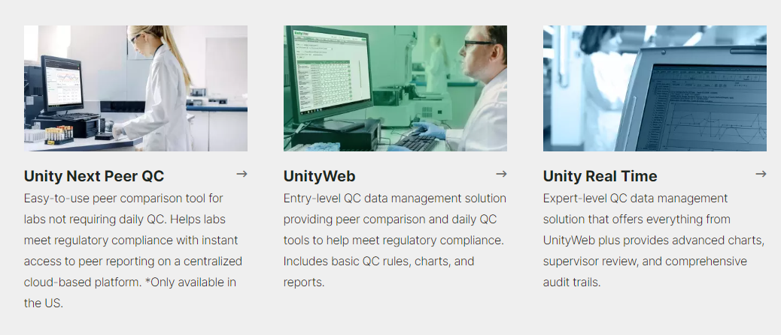
- Software Solutions
Unity Next Peer QC Easy-to-Use peer comparision tool for labs not requiring daily QC. Helps labs meet regulatory compliance with instant access to peer reporting on a centralized cloud-based platform. *Only available in the U.S. | UnityWeb Entry-level QC data management solution providing peer comparison and daily QC tools to help meet regulatory compliance. Includes basic QC rules, charts, and reports. | Unity Real Time Expert-level QC data management solution that offers everything from UnityWeb plus provides advanced charts, supervisor review, and comprehensive audit trails.

Slide 23
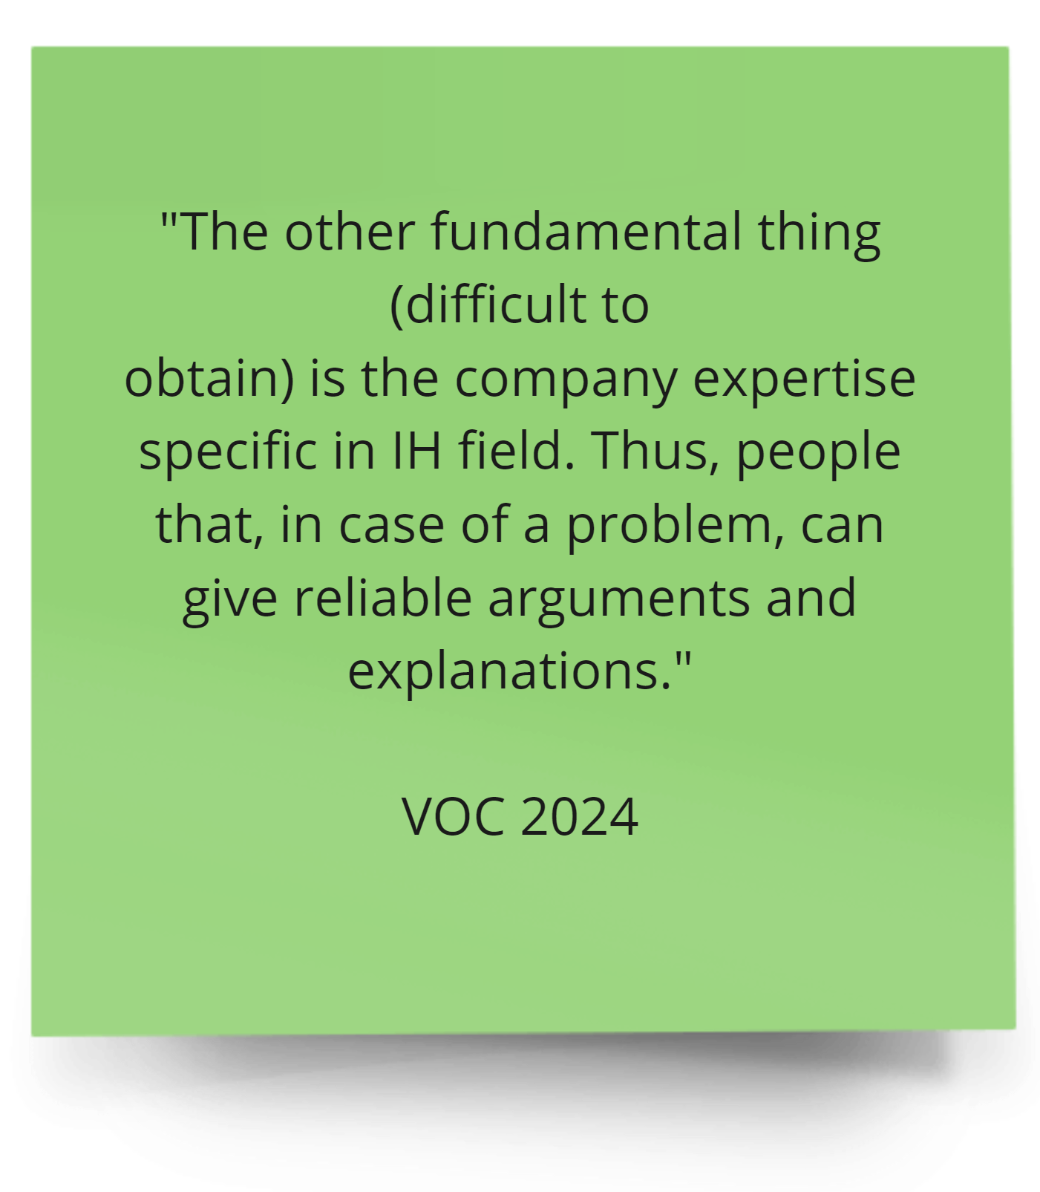




- Educational Tools

Slide 24
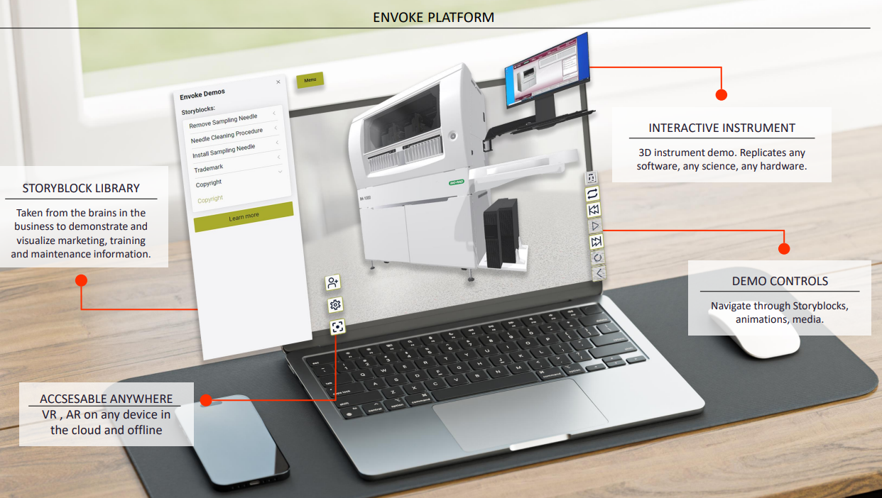
- Educational Tools
https://dashboard.envoke-demos.com/
This tool is NOT accessible by Channel partners

Slide 25

The values for our customers
Security
  Repeatability
  Reproducibility
  Standardization
    Peace of Mind
      Full Traceability
    Easiness for their work
  Launch a test in few clicks
    Time saving
      Emotional features for the customer:
      To be sure that the results reported are correct and the patient is well screened
      Lab image and customer trust

Slide 26
Before we start…
The selling with impact is based in our unique value proposition. But we should know that
“Finding something unique is almost impossible and when you do find it then it’s replicable in one way or another, relatively quickly.”
We should focus on “Relative differentiation”, where the goal is not to be unique, but instead have “more” of something than other brands do within the category.
We should choose to prioritize “attributes and associations that matter to our target consumers” which will prove enough to influence purchase decisions.
“Differentiation is not about uniqueness, it’s about difference.”
“Differentiation is about building a relative difference so being better or more well known for something”.
Source: Mark Ritson in Marketing week

Slide 27
Main Suppliers in IH Market

Slide 28
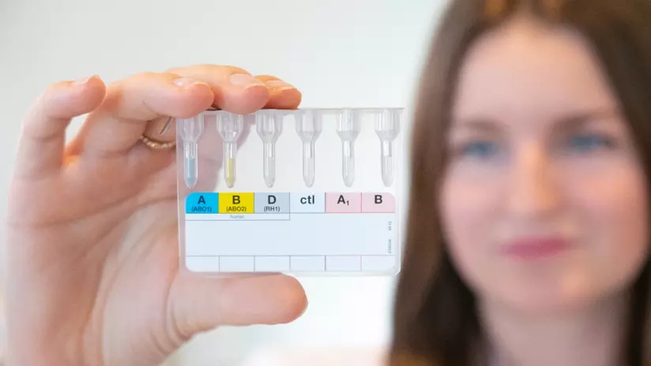
IH is a big player in the total Bio-Rad business
With 393.2 M$ revenue per year (2024 plan) Bio-Rad Immunohematology represents:
            24% Revenue of Total CDx
            41.6% Revenue of Total CDG

Slide 29
IH Main Players Market Share 2024
Others
18%
Bio-Rad
24%
Immucor
14%
QuidelOrtho
Formerly Ortho
Diagnostics
34%
Grifols
10%

Slide 30
Main Suppliers in IH Market
Key competitors |  | Technology, Country of origin and Type of Market
Immunohematology | Bio-Rad | Column agglutination-6 wells Founded in US California, 1952 The most comprehensive immunohematology products available from a single supplier
 | Grifols | Column agglutination-8 wells Founded in Barcelona, Spain in 1909 A pioneer in the plasma industry, also dedicated to IH and AI
 | Immucor-Werfen | Microplate technology Barcelona, Spain, 56 years in the market Werfen provides a complete diagnostic portfolio
 | Quidel-Ortho | Column agglutination Founded in USA, 1939 Global market leaders in IH
 | DiaPro/Across | Gel cards with 8 wells Turkish manufacturer Complete portfolio for diagnostics
 | Tulip Diagnostics | Column agglutination - 6 wells Indian company Diagnostics complete portfolio including POC

Slide 31

Geographic Presence of the Suppliers in IH Market
The main suppliers are present all over the world

Slide 32





Main Suppliers in IH Market
Supplier | Users (N) | Average Score (1 = Low / 10 = High) | Main Pros | Main Cons
 | 8 | 7.8 | Good performance Improved efficiency Robust Reliable and straightforward, well-received by staff | Lacks full customization TAT Compactness Occasional breakdowns
 | 10 | 7.9 | Reliable, familiar to staff Lots of suplliers in UK, easy to maintain, quick support for suppliers Easier to use Automation and functionality Robust | Occasional breakdowns
 | 8 | 8.6 | Reliable User friendly Good support Minimize errors and standardize testing Sensitivity, speed, the spectrum of tests Fast TAT High throughput Precise | Better TAT is needed
 | 3 | 8 | Easy of use | Bad quality plastic
High throughput
Bio-Rad – IHLabBehavior – Qual report – September 2024 - Confidential

Slide 33










Main Suppliers in IH Market

Slide 34
Grifols

Slide 35


- About
It is a global company, with more than 23,000 employees across the globe. But the story of this company begins in Spain in the early years of the twentieth century.
The company develops, produces and provides healthcare services and solutions in more than 110 countries.
A pioneer in the plasma industry, Grifols develops innovative plasma-derived medicines and other biopharmaceutical solutions that treat patients with chronic, rare, and, at times,
life-threatening conditions.
Grifols is focused on treating conditions across a broad range of therapeutic areas: immunology, hepatology and intensive care, pulmonology, hematology, neurology and infectious diseases.
Grifols is working in more than 30 countries and regions.
www.grifols.com

Slide 36

- About
Currently facing internal issues, canceled important events with
customers planned for soon.
Recently we received news that the commitments made in
tenders are not being fulfilled.
So, this can be the right time to approach to Grifols customers
and present our solution.
Its important to know that customers really appreciate the fact
that Grifols has Reference Labs where they can confirm
discrepancies or do studies.

Slide 37




- Same Technology
Feature | Bio-Rad | Grifols | Bio-Rad Added Value for the customer
Number of columns | 6 | 8 | Easy to use Practical Convenient Less waste of cards
Incubation Time | 15 minutes | 15 minutes
Centrifugation Time | 10 minutes | 9 minutes
Sample Volume | 10 mL for RBC suspension 50 uL for reverse and 25 mL serum, plasma for ABS | 10 mL for RBC suspension 50 mL for reverse and 25 mL serum, plasma for ABS
How long the column is valid after the opening | 2 hours | Need to be used immediately

Slide 38



- Cards
Storage at 2 – 25 °C
Some cards need fridge temperature
e.g. ABDVI+ confirmation card storage at 2 – 8 °C
The packaging size 2 x 25 per pack

Slide 39

- Cards Configuration
Bio-Rad offers exclusive cards, incl. the DAT IgG-Dilution and DAT IgG1/IgG3, which are not available from Grifols
The Bio-Rad ID-Antigen
Profile I and II cards contain
pre-dispensed antisera in the wells. Grifols cards lack this feature, leading to additional process steps and a longer time to obtain the desired outcome.
Lack of cards with prefilled reagent for
rare antigens.
Antigen profile I, II, III cards or Single
Antigen cards.
There are no anti-A1 and Anti-H cards.

Slide 40



- Cards
Bio-Rad has the more sophisticated range of cards for DAT
1 | Coombs and IgG cards | Coombs and IgG cards
2 | IgG-C3d-ctl | IgG-C3d-ctl
3 | IgG-IgA-IgM-C3c-C3d-ctl | AHG-IgG-IgA-IgM-C3c-C3d-C4-ctl
4 | DAT IgG1/IgG3 | No card
5 | DAT IgG Dilution | No card
The differentiation of the coated molecules
Information about the subclass composition of the IgG-antibodies
Subclasses IgG1 and IgG3 are considered to be clinically relevant in inducing accelerated red cell destruction
Evaluation of the numbers of IgG molecules per cell
Which influence the red cell destruction seen in Autoimmune Hemolytic Anemia (AIHA),
Hemolytic Disease of the newborn (HDN) and posttransfusion reactions

Slide 41
- Cards
Grifols solution allows to pre-treat the plasma which may thereafter be used for different testing (screening, panel and crossmatch).
Grifols solution has one major limitation: it may neutralize antibodies to Duffy antigen. This has been demonstrated in studies carried out in and is mentioned in their IFU.

Slide 42




- QC
Feature | Bio-Rad | Grifols | Bio-Rad Added Value for the customer
Simulated whole blood tubes only | Yes | Yes
Same QC products for different instruments | Yes | Yes
Cards for risk of hemolysis evaluation | Yes, Complete range | Yes, Limited range | Full range of tests to assure better answer to the patient
A2 Cell | Yes | No | Full range of tests to assure better answer to the patient
D weak cells for automated systems | Yes | No | Full range of tests to assure better answer to the patient
DAT positive IgG coated Cells | Yes | No | Full range of tests to assure better answer to the patient
DAT positive, C3b (C/d) coated cell | Yes | No | Full range of tests to assure better answer to the patient

Slide 43




- QC
Feature | Bio-Rad | Grifols | Bio-Rad Added Value for the customer
Cards Package size | 4x12,24x12,112x12 | 2x25 | Flexibility Adapted to the lab volume
Portfolio | More than 80 types of cards | 21 | Full range of tests to assure better answer to the patient
Cards for risk of hemolysis evaluation | Yes, Complete range | Yes, Limited range | Full range of tests to assure better answer to the patient
Possibility to do rare Ag on cards with prefilled reagent | Antigen Profile Cards. Single Ag Cards | No | Full range of tests to assure better answer to the patient
QC Material for DAT and Dweak | IH Modular QC 6, 7, 8 | No | Full range of tests to assure better answer to the patient
Possibility to buy QC vials separetly | Yes | No | Flexibility Adapted to the lab volume

Slide 44




- Instrumentation
LOW ACTIVITY | MEDIUM ACTIVITY | HIGH ACTIVITY
WADiana® | Erytra Eflexis® | Erytra®
DG Gel manual systems: DG Therm & DG Spin DG Reader Net

Slide 45

- Low volume
WADiana® |  | Bio-Rad. Incubator. Centrifuge. Swing. Banjo/Saxo Plus IH-Com and LIS Manual workstation

Slide 46

- Medium volumes
WADiana® |  | Bio-Rad. Manual or Semi Automated

Slide 47
- High volumes
Erytra® |  | Bio-Rad. IH-1000

Slide 48




- Eflexis
Erytra Eflexis | IH-500
A benchtop, compact model. Fully automated.
Process status indicator traffic light.
External touchscreen.
Continuous loading of cards, reagents, and samples with positive identification RBC reagens. 72 hours on board. | RBC 7 days on board
Well-by-well management Sample dilution – dilution station with self-washing cup | Disposable Diluent rack
Washing solutions: 1x 6 L DG Fluid A solution 1x 6 L DG Fluid B solution 2x 6 L waste solution | Continuous changing

Slide 49


- Eflexis
Erytra Eflexis | IH-500
High-resolution reading with a multi-functional CCD camera Card integrity check before and after processing Dispensing verification of the DG Gel cards High-definition color results
Bidirectional connectivity to the LIS Remote access to validate results Remote diagnostics for troubleshooting | IH-Web BriCare
Remaining time for samples to be completed Monitor instrument and samples status and real-time warning Check of discrepancies Complete results traceability report | OMT Onboard Monitoring Time

Slide 50
- Eflexis
 | Erytra Eflexis | IH-500
Capacity up to | 72 samples 46 reagents positions 200 cards | 50 samples 34 reagents positions 164 cards
Full ABO/Rh blood group typing Forward+Revers | 35 samples/hr | 48 samples/hr
Antibody Screening (I, II, III) | 72 samples/hr | 82 samples/hr
Type & Screen | 23 samples/hr | 32 samples/hr

Slide 51




- Eflexis

Slide 52


- Erytra
Higher throughput
Higher storage capacity
Reagent positions: 54 positions
Reagent agitation: 36 positions
Reagent loading system: Through 4 removable racks in 2 independent continuous access drawers
Loading capacity: A maximum of 400 cards
Erytra doesn’t provide:
7 days on board stability for all reagents
(Ortho’s on-board stability differs from reagent to reagent from 0, 2, 3 to maximum 5 days)
On Board Time management
Prioritization of a test or group of tests outside the STAT function

Slide 53
- Erytra
The Erytra requires a weekly backup which the user has to manually request. This takes approximately 1 hour and users are unable to process samples. If the backup fails, the operator has to restart the process. Our backup is daily and takes 2-3 mins, which is automatic and happens in the background, samples can still be processed.
The weekly maintenance takes between 1 hr to 1 hr 30 mins to complete.
Customers don’t tend to automate panels because of limited capacity and the analyser slows down when processing panels. Each panel test usually takes 45 mins.
Priming takes 20 mins before users can run a sample. The priming is a problem when the analyser is left idle for a period of time and has gone in standby mode.
It takes 20 minutes for startup due to priming.
There is no bi-di/ host query interface. In theory Grifols claims to offer this but I have never seen a site with this setup. The user has to load samples, refer to the paper request form, and interrogate the system to make the test requests.
Feedback from a Grifols customer in England, collected by Alice Tucker

Slide 54
- Erytra
There are no patient demographics on the on-board software, and the user can only distinguish the sample using the barcode number. The user cannot see patient name/ DOB/ other patient identifiers on the on-board software and therefore this isn’t translated across the printed order reports. There is a massive risk in error particularly for XM. N.B. on the reports there are patient demographic fields but no information on the patient ID.
The analyzer is not a trickle feed system and is a batch analyzer.
There is no auto-validation, however there is a multi-select button that the operator can use to transfer a number of results to the LIS, where they then review the result.
There is no sample preservation feature in case of short samples.
The DAT cards need to be stored in the fridge – however I think they were looking to update this?
There’s a button at the front of the analyzer which turns it to sleep mode.
Feedback from a Grifols customer in England, collected by Alice Tucker

Slide 55
- Erytra
The user does not need to log on with username/ password to access the on-board software. They can navigate through the tabs, gain access to the analyzer, however they need to enter their password to edit/ comment results.
Can load reagents on the fly but not wash solutions.
At QE and UHL they must pour pediatric samples into a separate tube because the Erytra system cannot sample directly from the tube. This is a huge patient risk, with potential for wrong sample/ loss of sample for newborns.
They don’t have anything equivalent to Unity or Ab ID. Their informatics/ IT is very basic.
Feedback from a Grifols customer in England, collected by Alice Tucker

Slide 56

- Eflexis
Eflexis is providing a bigger container for Washing solution (6l vs 4l on IH-500)
Bigger Storage
Significantly lower throughput for Full ABO/Rh: 35 vs. 48 for IH-500 test/hr
Eflexis doesn’t provide:
  Seven days on board stability
  (Ortho’s on-board stability differs
  from reagent to reagent
  from 0, 2, 3 to maximum 5 days)
  On Board Time management
  Prioritization of a test or group of
  tests outside the STAT function

Slide 57

- Titration
Old Titration module (Current) | New titration module (Enhanced)
Large volume of sample consumed | Low sample volume consumed (205 µl – 155 µl)
1:1 to 1:128 (using 1 gel card) | 1:1 to 1:2048 (using 2 gel cards)
No serial dilutions | Mimicked serial dilutions (in dilution cup)
Plasma/serum sample only | Whole blood tube
Automated vs Manual comparison study
Card | N. tests | % Agreement (LCB 95%) [1 TIT / 1-agg. Diff] | % Agreement (LCB 95%) [2 TIT Diff.]
AHG | 60 | 96.7% (89.9%) | 100% (95.1%)
IgG | 60 | 95.0% (87.6%) | 100% (95.1%)
Neutral | 65 | 100% (95.5%) | 100% (95.5%)

Slide 58



- Titration

Slide 59


- A^{b}ID Software
Bio-Rad. IH-A^{b}ID | Blood Typing Manager
Upload of Antigen Table via 2D barcode scan No internet connection required Suggestions for supplementary tests Integrates The Blood Group Antigen FactsBook | “Increase testing accurancy Take the subjectivity out of antibody identification with Blood Typing Manager. The Antibody Identification module interprets A^{b}ID testing, allowing you to make decisions fast without the guesswork.” Limitations of Grifols Blood Typing Manager Software Remote results editing is not possible, only viewing and approving. This can delay results and create possible discrepancies in repeat testing between the analyzer and the Blood Typing Manager Software. Reflex tests cannot be configured by the user and instead require intervention by Grifols. This reduces flexibility for laboratories. The system does not support third-party cells or expired cells for antibody identification, leading to a loss of traceability and requiring manual intervention in the testing process.

Slide 60




- Software
Don’t let your process test you.
Easy. Efficient. Secure.
A centralized management tool that connects all your Immunohematology data delivering fast results, increasing lab productivity and enhancing safety.

Slide 61




- Educational Resources
Educational Oppurtunities
Grifols has created a series of videos, webinars and educational resources for experienced blood bank technologists, transfusion medicine specialists, research scientists, and physicians.
Use the filter below to select your topic and language by choice.
Can a middleware improve the workflow efficiency of your immunohematology laboratory? Discover how with a real user experience

Slide 62
- Weaknesses
Requires user software interaction or manual drawer opening/closing for loading and unloading sample and reagent racks. This leads to increased operator interventions, longer processes, and a higher potential for errors.
Since there is no integrated instrument backup due to the availability of only one pipetting arm, it becomes necessary to install a second instrument as a backup. This requires additional laboratory space and incurs higher investment costs.
By using diluent bottles instead of pre-filled diluent racks, additional pipetting steps and increased consumption of washing solution for diluent sample preparation are necessary, which extends processing time for obtaining results.
The instrument has a smaller sample loading capacity, accommodating only 96 samples at a time. The IH-1000 System can accommodate 180 samples.

Slide 63

Based on a testing phase on an image bank from a total of 900’000 wells, IH.500 version 3.1.14 offers an improved reaction grading interpretation.
The increased performance of the reaction grading interpretation presents a better alignment with the visual reading of the processed gel-card and higher reading robustness with a benefit of a significant reduction of false results or non-interpretable results.
Value Proposition of the Improved Reaction Grading Interpretation
The new reaction grading interpretation, built from testing of more than 900’000 well images
Avoiding interpretation of artefacts like dust, particles, and light variation
An overall increased reliability for well interpretation and reduction of false results
A better detection of DP results and reduction of falsely detected DP’s to less than 5%
More specificity in the reaction interpretation in respect to the type of tests performed.
The reading behaves predictably and everywhere the same as it does not change in time.
Summary of the performance
The following table shows the improved performances comparing IH-500 version 2.2 (without the reaction grading improvement) and IH-500 version 3.1.14 (with the reaction grading improvement)
Based on a testing phase on an image bank from a total of 900’000 wells, IH-500 Version 3.1.14 offers an improved reaction grading interpretation.
The increased performance of the reaction grading interpretation presents a
Summary | Description | Before improvement | Improved reaction grading interpretation | Improvement
Conformity level | The result returned by IH-500, compared to the visual reading of the reaction | 96.1% | 99.3% | Increase of 3.2 pp (percentage point)
Sensitivity | Expected Positive reactions, correctly returned positive | 98.5% | 99.6% | Increase of 1.1 pp
Specificity | Expected negative reactions, correctly returned negative | 98.2% | 99.4% | Increase of 1.2 pp
Not returned result level | IH-500 is not able to return a result and returns a “?” | 0.6% | 0.2% | Divided by 3
False Negative (number) | Expected positive but returned negative | 35 | 0 | Reduced by 100%
These values were captured after the development of the improved reading algorithm.
IH-500 V3.1_notes.pdf

Slide 64

Increased reading robustness related to external factors.
The reading robustness has increased and shows a better tolerance toward variability brought by:
Variability of Gel-Cards: Dusts, particles, stuck inclusions to the card that will generate false positive or unjustified “?” Results.
Told variations (Gel-Card well not centred), generating unjustified “?” Results
Inter-instrument variability (camera settings, calibration, backlight intensity), generating too many unjustified “?” results.
The complex balance between positives (sensitivity) and negatives (specificity)
Sensitivity to the variability of production (cards holds deformability, colours rendering, cards tilting)
Focus on Well Control Performance
Out of 8463 ID gel cards
These values have been captured after the development of the improved reading algorithm.
Description (% of card) | V2.2 | V3.1 | Improvement
Conform | 94.6% | 99.5% | Increased by 4.9 pp
False OK | 0.3% | 0.2% | Reduced by 33%
False NOK | 5.1% | 0.3% | Reduced by 94%
External release
IH-500 V3.1_notes.pdf

Slide 65









- Real Case
* Collected from a Grifols customer, a Hospital in USA.

Slide 66

- Real Case by Fernando Carbonero
Hemovigilance solution provided by an external provider
Transfusion safety bands
Electronic Request
Transfusion Safety

Slide 67
- Real Case by Marlene Pinto
Portugal and Spain Sales teams were able to found a way to compete against Grifols total solution
(including Molecular Biology).
They provide every customer the possibility to confirm special cases-variants for D, doble populations, mix of Ab or
need of specific techniques (elution, adoptions) in a reference lab-Banc Sang y
Textis in Catalunya, Spain (one of the major reference labs in Spain).
This process is done by Bio Rad CTS, that sends a form to be fulfilled by the customer and collects the sample
to be sent to BST.
The result is received by the requester in less than one week.
This gives our customer the confidence in our solution and trust in this partnership.

Slide 68


- Real Case by Marlene Pinto
Example of a report sent to the customer

Slide 69


- Real Case by Marlene Pinto
Another way we are differentiating our solution is by hosting workshops and webinars featuring national specialists
in immunohematology (IH) who address key topics and share valuable insights in the field.

Slide 70

-Real Case by Alice Tucker*
Titrations
The Grifols solution doesn't mimic the same steps of a serial dilution as you would do so manually. Instead, the analyzers (both Erytra and Eflexis) would aspirate new sample for each dilution. This is technically not a serial dilution and wastes too much sample therefore is not fit for purpose. This is something that Grifols are working on to fix which will come with the next SW update.
Manual Reader
The lab does not use the Grifols reader because the middleware doesn't recognize results going via the reader as a manual test, which would not work for Electronic Issue (EI). Our Banjo and Saxo via IH-Com can flag results as manual.
Middleware
Middleware is not user friendly - the customer has spent 6 months into to trying to load confirm groups onto the machines but middleware and machines not talking to each other. They have been told to upgrade their middleware to BVM but they aren't keen to take the risk.
*Information collected at SNBTS and Luton

Slide 71
-Real Case by Alice Tucker*
Customer Service
The rep and their version of Tech Support is really hard to get hold of. Poor customer services from the sales team also.
Quality Issues
Shadowing on cards causing false pos reactions on QC (replacements having to be sent). Engineers have visited to adjust the camera however problem still persists.
*Information collected at SNBTS and Luton

Slide 72




- You should remember
Cards need to be used immediately:
- Easy to use
- Practical
- Convenient
- Less waste of cards
Cards storage at controlled temperature - less flexibility, need of fridge space
Less sophisticated range of cards, for example for DAT
Limited range of Quality Controls
RBC limited time onboard - not always ready to use
RBC diluent is an open vial. Less stable and risk of contamination
Non efficient Dara test

Slide 73
Quidel-Ortho

Slide 74

- About
Ortho is very well perceived by customers and the major fact they mention is the
higher sensitivity in the Ab Screening.
They are known for having a good and immediate support.
Ortho Products, Inc. is formed in Linden, N.J.
As a division of Johnson&Johnson
Ortho launches Ortho ProVue®, the first fully automated immunohematology system for use with the ID-Micro Typing SystemTM (ID-MTS) Gel Test in North America
Ortho introduces Ortho Summit, the first truly
automated blood and plasma screening in the U.S.
Ortho receives FDA clearance
for Ortho Vision®
1947
1998
2003
2016
1939
1979
2013
2015
2022
Ortho launches Ortho® Workstation
Quidel Corporation is founded in San Diego, CA
Quidel Corporation and
Ortho Clinical Diagnostics
Unite as QuidelOrtho with
an 80-year history of innovation
Ortho develops the first blood bank anti-D test
For the clinical market
Ortho receives FDA clearance for Vitros® automated solutions

Slide 75




- Same Technology / Different Matrix
ORTHO BIOVUE® Cassette
Glass beads cassettes used in the ORTHO VISION® MAX Swift are considerably less stable than gel cards. They are more sensitive to handling and transport, and supplementary centrifugation is required before their use. This can add complexity to the testing process.
Glass beads cassettes are semi-opaque and must be checked from both sides to ensure results consistency. But with transparent gel cards, the result is the same regardless of viewing point. ID-Cards are read only from one side, making the reading process faster and easier.

Slide 76
- Same Technology / Different Matrix
ORTHO BIOVUE® Cassette
A comparison of three column agglutination tests for red blood cell alloantibody identification
Siska Blomme¹, Emilie De Maertelaere² and Eline Verhoye³
Conclusion
Three test cell panels for identification of irregular RBC antibodies were compared: Autovue® Innova (Ortho Clinical Diagnostics (OCD), Milan, Italy),
ID-GelStation (Bio-Rad Laboratories, CA, USA) and Erytra® (Grifols, Barcelona, Spain). The resulting antibody identifications showed subtle differences between the three methods, with the gel card system (Bio-Rad and Grifols) being superior to the glass card system (Ortho) for analyzing stored samples. However, no manifest advantage for a particular method in case of facilitation of antibody identification was found. In conclusion, all three systems were considered reliable and safe for routine testing in the immunohematology laboratory.

Slide 77
- Same Technology / Different Matrix
ORTHO BIOVUE® Cassette
Comparison of two column agglutination tests for red blood cell antibody
Jonas Sawierucha¹, Marion Posset¹, Viola Hähnel¹, Christian L. Johnson¹, James A. Hutchinson², Norbert Ahrens¹
Institute for Clinical Chemistry and Laboratory Medicine, Transfusion Medicine, University Hospital Regensburg, Germany.
Department of Surgery, University Hospital Regensburg, Germany.
Background
Several sensitive methods are available for red blood cell (RBC) antibody screening. Among these, gel and glass card systems have demonstrated comparably good performance in retrospective studies and are widely used in routine patient diagnostics, but their performance in prospective studies has not been sufficiently characterised.
Patients and methods
Gel card (Bio-Rad DiaMed) and glass bead-based (Ortho Clinical Diagnostics) column agglutination technologies were used to screen for antibodies prospectively (group A) and for antibody identification in stored and fresh samples known to contain RBC antibodies retrospectively (group B). Untreated reagent RBCs and either papain-treated (Bio-Rad) or ficin-treated panel C cells (Ortho) were used for antibody identification.
Results
RBC-reactive antibodies were detected in 22 of 1000 group A samples, three of which tested positive only by gel card agglutination, and four only by glass bead agglutination (incl. one false positive each). Group B comprised 202 sera with known antibodies: 33 of these samples contained 36 antibodies detected only by gel card agglutination. Discrepancies mostly involved weak antibodies reactive by enzyme only. Two sera contained antibody mixtures that neither system detected completely. Of note, in antibody differentiation batches one and two, anti Luª was reactive in 7 of 7 and 1 of 8 samples, respectively.
Conclusion
Both column agglutination tests for red cell antibodies had equal sensitivity and specificity with unstored samples. In stored samples, weak and enzyme-only antibodies were more frequently detected with the gel card system.

Slide 78


- Cards
FEATURE
The filter in the column | The glass beads | The gel
The centrifugation time | 5 minutes | 10 minutes
The incubation time | 10 to 30 minutes | 15 minutes
The sample volume | 3-5% RBC suspension: 10 µl 0.8% RBC suspension: 50 µl Serum or Plasma: 40 µl | 3-5% RBC suspension: 10 µl 0.8% RBC suspension: 50 µl Serum or Plasma: 25 µl or 50 µl for reverse
ORTHO VISION® MAX Swift offers a 5-minute centrifugation time, contributing to faster and more efficient sample processing.
While the 5-minute centrifugation time in the ORTHO VISION® MAX Swift is
advantageous for the turnaround time of the first sample, it may not significantly
impact the overall result when working in batch. This is because the internal
instrument processing and workflow of the ORTHO VISION® MAX Swift are less
efficient than the IH-1000 System.
Notes:
Our commercial RBC have all the same concentration

Slide 79





- Cards
FEATURE
Package size - cards | 100/400 | 48/288/1344
How long the column is valid after opening? | 1 hour | 2 hours
How many different types of cards in the offer? | 18 | More than 80 types of cards
Possibility of detection of variant DVI | Recently launched | Anti-A, Anti-B, Anti-AB, Anti-DVI+, Anti-DVI-, ctl Anti-A, Anti-B, Anti-AB, Anti-DVI+, Anti-CDE, ctl 2x Anti-A, Anti-B, Anti-DVI+ …
Cards for extended DAT | NO | YES
Notes:
Daratumumab

Slide 80


- QC
ORTHO CONFIDENCETM WB Simulated Whole Blood Quality Control Kit
Vial 1 | Group A1B | D+C+E+c+e+ (R1R2)
Vial 2 | Group O | D+C+E-c-e+ (R1R1) K+, anti-A, anti-B, anti-c
Vial 3 | Group A | D+C-E+c+e- (R2R2) Fy(a-), anti-B, anti-Fya
Vial 4 | Group B | D-C-E-c+e+ (rr) K-, anti-A, anti-D (0.1 IU/mL)

Slide 81




- Instrumentation
LOW ACTIVITY | MEDIUM ACTIVITY | HIGH ACTIVITY
Ortho® Optix Reader Ortho® Workstation | Ortho® Vision Swift | Ortho® Vision Max

Slide 82


- Instrumentation
The new system is a face lift of the old one
ORTHO VisionTM
ORTHO Vision® Swift

Slide 83
- Instrumentation
Ortho VisionTM Analyzer automates in vitro Immunohematology testing of human blood utalizing ORTHO BioVue® Cassette technology.
Automates test processing functions including liquid pipetting, reagent handling, incubation, centrifugation, reaction grading and interpretation and data management requirements using ORTHO BioVue® Cassettes and digital image processing.
Standalone instrument or interfaced to the LIS
Monitors critical processing monitoring and provides for complete management of system maintenance and quality control.
Ortho Vision Swift Analyzer analyzes automates in vitro Immunohematology testing of human blood utilizing Ortho BioVue® System technology.
Automates test processing functions including liquid pipetting, reagent handling, incubation, centrifugation, reacting grading and interpretation, and data management requirements using ORTHO BioVue® Cassettes and digital image processing.
Standalone instrument or interfaced to the LIS
Fully compatible with Ortho Connect® to maximize the efficiency of your data, workflow, and resources for integration across your lab or network.
Samples: Up to 42 samples can be loaded, 6 Sample Racks holding 7 tubes each
Ortho BioVue system supply drawer: 148 Ortho BioVue cassettes (7 sleeves of 20 + 8 in dual purpose rack)
Reagent red blood cell (RBC) supply: Supports 3 independent RBC racks, each can hold 11-3 mL vials or 6-10 mL vials, incl. various combinations. The 10 mL rack can accommodate reverse grouping and antibody detection (screen) RRBC. The 3 mL rack can accommodate reverse group, antibody detection and antibody identification RRBC.
Diluent: 6 bottles (Ortho BioVue system)
- 1x 50 mL position for Ortho Bliss - 4x 10 mL position for red cell diluents
- 1x 50 mL position for red cell diluent - Onboard liquid reagent capacity of 4.7 L of saline and 1 L of deionized water
Heated Incubator: 12 Ortho BioVue cassettes
Room Temperature Incubator: 24 Ortho BioVue cassettes
Centrifuge: 2 centrifuges, 10 Ortho BioVue cassettes per centrifuge, 5 minute centrifugation time.
Waste: 5.2 liters, 100 Ortho BioVue cassettes, Optional off-board plumbing draining available.

Slide 84




- Instrumentation
ORTHO VisionTM
The
samples,
reagents
and
consumables
load
Very low capacity for the system liquids
The main cover
The system
liquids
The cassette drawer

Slide 85

- Instrumentation
Cassette Drawer
7 sleeves of 20 cassettes
After closing the drawer the system count the number of cassettes,
verify lot number, expiry date, type of cassette by picking up the first
cassette of each sleeve and passing it by the camera.

Slide 86

- Instrumentation
Review Sleeve Drawer
Coloured part of the sleeve is for low volume usage
cassettes and for partially used cassettes.
Non coloured part of the sleeve is used to bring
cassettes forward for manual inspection.

Slide 87

- Instrumentation
The sample/reagent/consumables access door
3 rings concept station
The outer ring for the sample
Max. 6 racks of 7 positions = 42 samples
Diluent plate in the middle is behind the sample quadrant
Max. 6 racks of 17 wells = 102 wells – serial dilutions
The reagent racks are in the internal ring
Capacity is 33
Temperature 18-20 °C
RBC 2/5 days on board

Slide 88

- Instrumentation
 | The analyser has cap detection for both samples and reagents.
 | The traffic light and its different statuses: Green: everything is fine Yellow: something developing that may soon require attention but still working Red: stopped as an intervention of the user is required |  | Images of the cassette can be viewed in greyscale or colour, and can be reviewed remotely.
 | The gripper not only transports the cassettes around the system, but also presents the cassettes to the reader and has a revolving head which allows both sides to be read. It is also responsible for picking up the punching devices, executing the punch and transporting the device back. |  | The punch device has 17 punches that cover all punch configurations so no columns are wasted

Slide 89


- Instrumentation
Major differences
Daily Maintenance | Tip decontamination about 15-20 min. | Maintenance free
What is the stability of RBC on-board? | 5 days for antibody screening 36 hours for reverse typing | 7 days on-board stability
The differences between philosophy of samples loading on IH-500 and Vision systems | Only one size tube per sample rack-dedicated racks Loading the patient samples needs sw interventions | Automatic detection of sample tubes size Easy loading Continuous loading of samples & urgent sample takes priority
Throughput Type & Screen | 18 tests/h | 32 tests/h

Slide 90

- Instrumentation
Comparison automation Bio-Rad – Ortho Clinical Diagnostics
The comparison includes the entire process of sample processing with reporting (from receipt of samples to delivery of blood bags and reports)
There is real potential for optimization, among other thing. In reviewing the analytics. Currently e.g. from the habit of “old ortho times” the anti-Kell was carried out in duplicate for all patients. Rilibäk does not ask for this, but unnecessarily delays the analysis in the device are the consequence. Furthermore, unnecessary waiting times for the samples extend the turnaround time (TAT) – as it is often the case at the moment. The background here is the way in which routine samples are started in order to cope with the increased frequency of urgent samples at all times. This and the also increased sample volume in the last 2 years currently leads to an undesirable shift in the processing of these samples to late shift.
When comparing the processing of a single sample, the result is faster at the AVI and in the future at
the vision also than at the IH-500. This is due to the methodology. With DiaMed gel card technology,
each card will be centrifuges for 10 minutes, the ortho-cassettes will be centrifuged for only 5 minutes.
When comparing the processing of a mixed small series, see the figure below, this difference is put into perspective. Depending on the profiles, the IH-500 may be a few minutes faster.

Slide 91


- IH-500 vs. Ortho’s Vision
Ortho has five minutes centrifugation time: fast ABO result in emergency situations
Vision doesn’t provide:
  Seven days on board stability for all reagents.
  (Ortho’s on-board stability differs from reagent to reagent from 0, 2, 3 to maximum 5 days)
  Intelligent On-Board time management
  Automated Titration up to a 1:2048 dilution
  Real Random Access
Notes:
Vision is a medium volume instrument. Its only advantage in respect to the IH-500 is the fast centrifugation time.

Slide 92


- IH-500 vs. Ortho’s Vision Max
Ortho has five minutes centrifugation time: fast ABO result in emergency situations
Vision Max is a big instrument with a higher throughput and storage capacity
Vision Max doesn’t provide:
  Seven days on board stability for all reagents.
  (Ortho’s on-board stability differs from reagent to reagent from 0, 2, 3 to maximum 5 days)
  Intelligent On-Board time management
  Automated Titration up to a 1:2048 dilution
  Real Random Access
Notes:
Vision Max is a high volume instrument dedicated for a much more intense activity than IH-500. Its major advantages in respect to the IH-500 is the high throughput and the fast centrifugation time.

Slide 93
- Titration
Current offer
1:1 to 1:1024
Serial dilutions (2-fold) in the regular dilution wells
1:1 – 1:1024, or preferred range, i.e., 1:1 – 1:64, 1:128 – 1:1024 etc.
Possible to pipette single dilution points only to the cards, i.e., 1:128
Not possible to perform dilutions outside of the 2-fold range, i.e., 1:25, 1:50 etc.
Notes:
Vision Max is a high volume instrument dedicated for a much more intense activity than IH-500. Its major advantages in respect to the IH-500 is the high throughput and the fast centrifugation time.

Slide 94

- A^{b}ID Software
Upload of Antigen Table via 2D barcode scan No internet connection required | Need internet connection to upload antigen table
Suggestions for supplementary tests Integrates The Blood Group Antigen FactsBook

Slide 95





- Software
Ortho Connect® Lab
Management
Software

Slide 96
- Software
Ortho Connect®
Lab Management Software
Our lab automation software is designed to standardize your immunohematology lab operations, simplify repetitive tasks, and deliver improved productivity so you can focus on providing the best patient care.
Centralize and streamline operations Through a single connection, you can control data and metrics, optimize ressources, and elevate patient care within your lab and across your network. | Create a seamless flow of information Review and approve results, set notifications, and generate consistent reports across labs with the QuidelOrtho immunohematology portfolio. | Stay informed Access results from the Ortho Vision® Analyzer and Ortho OptixTM Reader across multiple sites. | Gain insights and troubleshoot faster Analyze usage patterns and assay, instrument and laboratory performance data, so you can answer questions quickly and track predictive measures.
Access anywhere Get result and stay connected – even if your LIS goes down through server-based software. | Standardize workflows Implement standard safety checks and quality control, standardize approval escalations, and create consistent rules to ensure standardization and compliance. | Streamline processes Boost productivity and efficiency from a centralized hub for your automated and manual testing. | Trust your results and ensure compliance Ensure standard operating procedures and regulations are followed and documented, and quickly access historical patient data to meet compliance and traceability goals.

Slide 97


- Educational Ressources
Educational programs
Informative podcasts
E-learning, videos and how-to-documents

Slide 98
- Weaknesses
The ORTHO VISION® MAX Swift System requires more software and manual operator interactions for loading and unloading samples and reagents. Together with the waiting time to unlock the loading station door, these supplementary steps prolong processing time.
With four pipetting needles on one single arm, the ORTHO VISION® MAX Swift System is susceptible to a 100% breakdown if the arm gets blocked.
Evaporation caps are required for reagent red blood cell vials in the ORTHO VISION® MAX Swift System to prevent evaporation during instrument use. This necessitates manual operator steps before loading them into the instrument.
With the ORTHO VISION® MAX Swift System, more pipetting steps are required for diluent sample preparation due to the use of empty dilution trays.
The lack of integrated instrument backup on the ORTHO VISION® MAX Swift necessitates a second system and more space in the laboratory, increasing investment costs.
Daily, weekly, and monthly maintenance requirements for the ORTHO VISION® MAX Swift require more operator time spent on maintenance tasks and about 50% more instrument downtime for maintenance than the IH-1000 System, affecting overall operational efficiency.
Glass beads cassettes used in the ORTHO VISION® MAX Swift are considerably less stable than gel cards. They are more sensitive to handling and transport, and supplementary centrifugation is required before their use. This can add complexity to the testing process.
Daily 15-minute probe maintenance is necessary on ORTHO VISION® MAX Swift due to the less efficient cleaning solution and increased occurrences of carry-over.
The RT incubator on the ORTHO VISION® MAX Swift has 24 positions, but only 16 are available for use, reducing flexibility. Eight positions on the ORTHO VISION® MAX Swift are reserved for storing partially used cards. In contrast, the IH-1000 System offers 64 RT incubation positions and a dedicated space to store 9 partially used cards.
Glass beads cassettes are semi-opaque and must be checked from both sides to ensure results consistency. But with transparent gel cards, the result is the same regardless of viewing point. ID-Cards are read only from one side, making the reading process faster and easier.

Slide 99



- You should remember
-Technology: column agglutination, comprised of glass beads and
reagent contained in a column. Not GEL.
-Incubation Time is higher, lower throughput
-Card portfolio is reduced
-Short shelf life of the cards
-Not user friendly
-Ortho has five minutes centrifugation time: fast ABO result in emergency situations

Slide 100
Immucor-Werfen

Slide 101

- About Werfen
Founded in 1966, Werfen is a worldwide developer, manufacturer and distributor of Specialized Diagnostic instruments, related reagents, automation workcells, and data management solutions for use primarily in hospitals and independent clinical laboratories. The Company's business lines include Hemostasis, Acute Care Diagnostics, Autoimmunity, and Original Equipment Manufacturing (OEM). Werfen operates directly in more than 30 countries and in more than 100 territories through distributors. For more information, visit werfen.com

Slide 102

- About Immucor
Founded in 1982, Immucor is a global leader in Transfusion and Transplant diagnostics, facilitating patient-donor compatibility. The Company strives to create a world where anyone, anywhere in need of a transfusion or a transplant receives the right blood or transplant that is safe, accessible, and affordable. With the right match, a life can be transformed, together. To learn more, visit immucor.com.
Immucor was acquired by Werfen in November 2022.

Slide 103

- About
Immucor has a less positive perception from customers, specially when we speak about the instruments.
They speak about :
Frequent breakdown
Little capacity of centrifuge and incubator
Lower sensitivity and repeatability

Slide 104








- Technology

Slide 105

- Technology

Slide 106



- Technology

Slide 107

- Technology

Slide 108




- Technology

Slide 109



Slide 110




- IH Portfolio

Slide 111



- QC
Competency Kits: Comprehensive & Convenient
Werfen is committed to supporting the testing you perform by offering a complete and convenient line of competency testing products – from basic to advanced. Results can be submitted online via the LEARN™ website. Plus, CPD credits are available with each kit at no additional cost.

Slide 112

- Instrumentation
Werfen’s Capture Workstation
Small volume labs or as a back-up to Werfen automation
Option to extend incubation time up to 60 minutes, the upper limit for antibody detection.

Slide 113










- Echo Lumena

Slide 114



Its 20 seconds against 40 minutes without leaving the instrument
To start the Echo, the user needs to do 10 clicks in the software
- Echo Lumena

Slide 115

- Echo Lumena

Slide 116



- Neo Iris

Slide 117



- Neo Iris
No real STAT function

Slide 118


- Neo Iris

Slide 119

- Instrumentation

Slide 120



- Instrumentation
Neo Iris – Too Big
Echo Lumena – Too Small
No Manual workplace backup

Slide 121



- Instrumentation
IH-1000 vs. Neo/Neo Iris
Less weight (213 kg vs. 395 kg)
Higher throughput for Abs (+50%)
Cap detection

Slide 122

- IH-500 vs. Neo Iris
Instead of one Neo Iris we can offer two IH-500
Provides a true backup
IH-500 offers a longer reagent on-board time with the active cooling for the reagent compartment
Less additional workspace is required in the laboratory: the system can be easily placed on an existing workbench
The throughput for AB Screening is competitive in price/test

Slide 123
- IH-500 vs. Echo Lumena
IH-500 vs. Echo/Echo Lumena
- Integrated PC
- Higher throughput for type & screen (+100%)
- Higher throughput for blood grouping (+300%)
- Higher throughput for Abs (+400%)
- Higher sample loading capacity (50 vs 20 =more walk-away time)
- More variety of cards and test parameters (=more flexibility for the customer)
- More reagents on board (34 vs 16)
- Cooled Reagent storage
- Cap Detection

Slide 124
- Instrumentation
IH-500 has a much higher level of automation and offers a much higher throughput
IH-500 is permanent ready to process STAT samples
IH-500 offers much more test parameters, sample throughput, advanced technology, and much higher level of automatic processing than ECHO

Slide 125
- Titration Neo Iris
ABO Titration Assays
IgG
Low titer range (8-well assay) 1:128 by doubling dilutions
High titer range (8-well assay) 1:16 – to 1:4096 by dilutions starting from 16
High Titer Screening Assays (4-well assay) 1:16 to 1:128 by doubling dilutions starting from 16
IgM
Low titer range (8-well assay) 1 :128 by doubling dilutions
High Titer Screening Assays (4-well assay) 1:16 to 1:128 by doubling dilutions starting from 16
Non ABO titration assays (no information about the titration range)
Titer IgG Panoscreen I, II, III
Titer IgG Panoscreen EXTEND I, II, III, IV, V

Slide 126
- Titration Echo Lumena
ABO Titration Assays
IgG
Low titer range (8-well assay) 1:128 by doubling dilutions
High titer range (8-well assay) 1:16 – to 1:4096 by dilutions starting from 16
High Titer Screening Assays (4-well assay) 1:16 to 1:128 by doubling dilutions starting from 16
IgM
Low titer range (8-well assay) 1 :128 by doubling dilutions
High Titer Screening Assays (4-well assay) 1:16 to 1:128 by doubling dilutions starting from 16

Slide 127

- Weaknesses
The NEO Iris® System has two pipetting arms: the left arm with four probes exclusively for sample pipetting, and the right arm with one probe primarily for reagents pipetting. If the left arm is blocked, processing time is significantly reduced. However, if the right arm is blocked, the system would be stopped due to the impossibility of reagents pipetting.
The extensive manual steps in loading and unloading microplates and the software interactions for loading samples and initiating test runs prolong testing time.
Stirballs must be added manually to the cellular reagents to keep them suspended during testing, resulting in more operator intervention and an increased risk of contamination and reagent neutralization if the stirballs are touched.
Daily, weekly, and monthly maintenance requirements on NEO Iris® result in more operator time being spent on maintenance tasks and increased instrument downtime for maintenance, reducing overall operational efficiency.
The NEO Iris® System offers no integrated instrument backup due to having only one centrifuge and lacking the ability to substitute pipetting arms. This necessitates a second system and more space in the laboratory, resulting in higher costs.
The assays offer is less extensive than that of the IH-1000 System, potentially necessitating the installation of additional automated systems to meet laboratory demands.
Customers using capture microplates resort to gel technology as a manual backup due to difficulties in reading, grading, and validating microplate reactions.

Slide 128







- ImmuLINK

Slide 129


- blud_direct

Slide 130


- Educational Ressources
A complete line of courses with
immediate certificate.

Slide 131




- Educational Ressources
.

Slide 132


You should remember
-Microplate: old fashion technology
-Very limited sample and reagent capacity
-Low Throughput for Echo Lumena
-No Manual workplace backup
-Specificity and sensibility is overall reduced
-No cap detection
-No real STAT
-Batch mode only works for a very big number of samples arriving in the lab
at the same time

Slide 133
DiaPro/Across

Slide 134



- About
Dia Pro, as being the youngest and most dynamic member of our companies, was established in 2007 with the aim of producing last generation
Immunohematology Systems based on Gel Technology. Construction of purpose designed facility began in 2007 and was completed in 22 months.
Spreading over 4500m2 indoor area, our factory consists of production areas including Class C & D clean rooms, laboratory areas, warehouses
with standard and temperature controlled zones, maintenance and technical service department and administrative area. Our company ha
s adopted the highest standards of production principles since its establishment and qualified to obtain CE certificate by having developed
its production under ISO 9001:2015, ISO 13485:2016 directives within the scope of IVDR 2017/746 and MDR 2017/745 Ministry of Health
Diagnostic Medical Device Regulations. After having completed a challenging 5-years of R&D process, the first range of products,
Across Gel®️ cards and Across System®️ equipment were introduced into transfusion community in 2012.
Being the first manufacturer of Gel centrifugation kits and equipment's in Turkey, Dia Pro has become one of the world’s known companies in this
field. Dia Pro is a World class manufacturer of immunohematology products in Turkey and is committed to maintain its position by pursuing
technological innovations.
Website
  http://www.diapro.com.tr
Company size
  51-200 employees
Headquarters
  İstanbul, Üsküdar

Slide 135

- Geographic Presence in IH Market
DiaPro/Across, is a Turkish company
covering 89 countries (in darker blue)
Dia Pro Medical Devices: Overview | LinkedIn

Slide 136




- Technology
Range of gel card systems, comprising of 8 column gel
– ABO grouping
– Rhesus phenotyping
– Cross matching
– IAT Testing
– DAT Testing
– Internal Quality Control

Slide 137






- Cards Portfolio

Slide 138




- QC

Slide 139

- Automation

Slide 140

- Automation

Slide 141

- Automation

Slide 142











- Automation
Features | Bio-Rad IH-500 | Diapro/Across Octo-Hawk | Bio-Rad IH-1000 | Diapro/Across Octo-M | Added Value
Card Loading Capacity | 164 | 100 | 240 | 200 | Higher througput
Reagent Loading capacity | 34 | 24 | 28 | 12 | Higher througput
Diluent Loading Capacity | 4 diluent racks | 2 bottles | RTU Diluent racks | 4 bottles for diluents | Ready to use diluent racks, flexibility, easy of use, less risk of contaminations
Sample Loading Capacity | 50 | 72 | 180 | 96 | Higher througput
Centrifuge | 2x12= 24 cards | 12 cards | 3x12=36 cards | 24 cards | Higher througput
Incubator | 37C, 28 cards | 37C, 12 cards capacity | 37C, 28 cards | 37C, 24 cards | Higher througput
Diluent | RTU | 1 space for 96 wells | RTU Diluent racks | 3 places for 96 well plates | RTU racks with barcodes. Safety and security
Cooler for reagents |  |  | NO | NO | However, 2 days of onboarding stability
STAT | Separate STAT racks | NO | Separate STAT racks | NO | Real STAT Feature
Titration | YES | NO | NO | NO | Less manual work, safety
Needles | 1 | 2 | 2 | 2 | Separate piercing module: The needles are working independently, more flexibility, less downtime for instrument, less contamination risk
Software | IH-COM IH-Web BRiCare IH-AbID | No | IH-COM IH-Web BRiCare IH-AbID | NO | Combine Multiple Instruments Integrated Manual Workplace

Slide 143

- Software

Slide 144
- Educational Ressources

Slide 145
- You should remember
-Very limited Card Portfolio
-Limited Quality Control Portfolio
-Lower throughput, even in the high-volume system
-Less flexibility
-Doesn’t have a real STAT Feature
-More risk of contaminations due to use of needles
-No Coomun database for multiple systems: Not possible to Combine Multiple Instruments,
No Integrated Manual Workplace, one LIS per system
-No educational resources
-Has a remote solution for support (like BRIcare)
-Turkish company with limited branding

Slide 146
Tulip Diagnostics

Slide 147



- About
One of the leading Indian diagnostic company, which is involved in the manufacture and marketing of in-vitro diagnostic reagents and kits both nationally and internationally.
Products for Blood banks are CE marked and ISO 13485 certified.

Slide 148

- Geographical Presence in IH Market
Tulip Diagnostics, being an Indian company,
is mostly present in Asia (covering 88 countries).
Tulip Diagnostics: Leading IVD Manufacturer - Company Divisions – Tulip (tulipgroup.com)

Slide 149

- Same Technology
Feature | Bio-Rad | Tulip | Bio-Rad Added Value for the customer
Number of columns | 6 | 6
Incubation Time | 15 minutes | 10 minutes
Centrifugation Time | 10 minutes | 10 minutes
Sample Volume | 10 μL for RBC suspension, 50 μL for reverse and 25 μL serum, plasma for ABS | 10 μL for RBC suspension, 50 μL for reverse and 25 μL serum, plasma for ABS
How long the column is valid after the opening | 2 hours | Need to be used immediately | Easy to use Practical Convenient Less waste of cards
All Matrix gel cards should be centrifuged for one complete cycle (10 minutes) in gel card centrifuge before use.
The Anti-D does not detect the D VI variant.

Slide 150


- Same Technology

Slide 151


- Portfolio

Slide 152









- Portfolio

Slide 153




- Portfolio

Slide 154





- Portfolio

Slide 155



- QC

Slide 156


- Automation

Slide 157


- Automation
Fully automated processor for Matrix gel cards based on Gel Column Agglutination Technology.
Capacity to load 60 Matrix Gel cards.
Dual needle pipetting system for preparing cell suspension and pipetting into Matrix gel cards for enhanced speed.
Independent Robotic Transfer arm for transportation of Matrix gel cards between different modules.
Incubation racks with 24 Matrix gel cards loading capacity.
Centrifuge of 85g with 24 Matrix gel cards capacity.
Sample loading capacity for 96 primary tubes.

Slide 158

- Automation
2 Barcode scanner: One for samples and other for Matrix gel cards.
Gel Card reader for reading the reactions and interpretation of results.
1 dilution plate of 96 wells for preparation of red cell suspension.
STAT mode facility for priority samples.
Complete usage of unused microtubes as software remembers the left over microtubes in Matrix gel card and makes then available for use in next testing.

Slide 159



- Automation

Slide 160
- Automation

Slide 161
- Automation

Slide 162
- Automation

Slide 163


- Automation

Slide 164


- Automation
Fully automated gel card processor
Throughput 40 tests/hour
Single needle system for preparing
cell suspension
Modular System Random access with
STAT facility
Integrated Barcode System
Onboard Inventory Management

Slide 165


- Software

Slide 166



- Educational Ressources

Slide 167


- Educational Ressources

Slide 168
- You should remember
-All Matrix gel cards should be centrifuged for one complete cycle (10 minutes) in gel card centrifuge before use
-The Anti-D does not detect the D VI variant
-Very limited gel cards portfolio
-Cards interpretation is difficult
-Only one QC vial in the portfolio
-Old fashion publications as educational resources
-No software mentioned in the information available

Slide 169
IH Real Scenarios

Slide 170

IH – Automated solution by Gaetano Di Bella (IHD FSS)
In Italy, several tenders are managed at regional level, involving big, medium and small hospitals; in the same tender high and medium productivity systems are required and the instruments must have the same specifications and features.
Our competitors can offer different instruments with the same characteristics:
1. Same system liquid
2. Same software
3. Titration with dilutions selection
4. Same rack (at least for samples)
5. Same on-board time stability for reagent
6. Same partially reusable cards modality
7. Same maintenance (time)
8. Same results with cold antibody (IH-500 centrifuges)
9. Additional card reader with color camera
In these big tenders the priority is to have and maintain unique characteristics to have the possibility to participate with a good technical score that allow us to propose an offer with the appropriate margin; it is very important to cover at least some of these critical point to increase our business.

Slide 171
Supporting Articles

Slide 172
Articles about competition
https://biorad-my.sharepoint.com/:f:/g/personal/u014747_global_bio-rad_com/EgA8NVyXJ_dGhMbDCMm648cBIQi3S8gsI-gVKy6oyg-QxQ?e=6xqSvS

Slide 173
Competitive instruments comparison

Slide 174
Competitive instruments comparison
https://biorad.sharepoint.com/:x:/r/sites/IH-MarketingInnovation/_layouts/15/Doc.aspx?sourcedoc=%7BA91A92B5-9FF8-4672-BA3A-3ADC0E54B9F6%7D&file=WD%20Competitive%20Instrument%20comparison.xlsx&action=default&mobileredirect=true

Slide 175


Slide 176

Competitive pack
Launched in January 2025
Last update made by Marilia Tavares, IH Product Manager in December 2024
Please contact
marilia_tavares@bio-rad.com
cecile_lesturgeon@bio-rad.com
Raphael_muniz@bio-rad.com
in case of any updated to be done.

